Slide 1
Academic Success Department Meeting Assessment Update
Dr. Joseph F. van Gaalen, Asst. VP, IR, Assessment, & Effectiveness
Team AASPIRE
Assessment – Accountability – Sponsored Programs – Institutional Research - Effectiveness
April 10, 2020

Slide 2
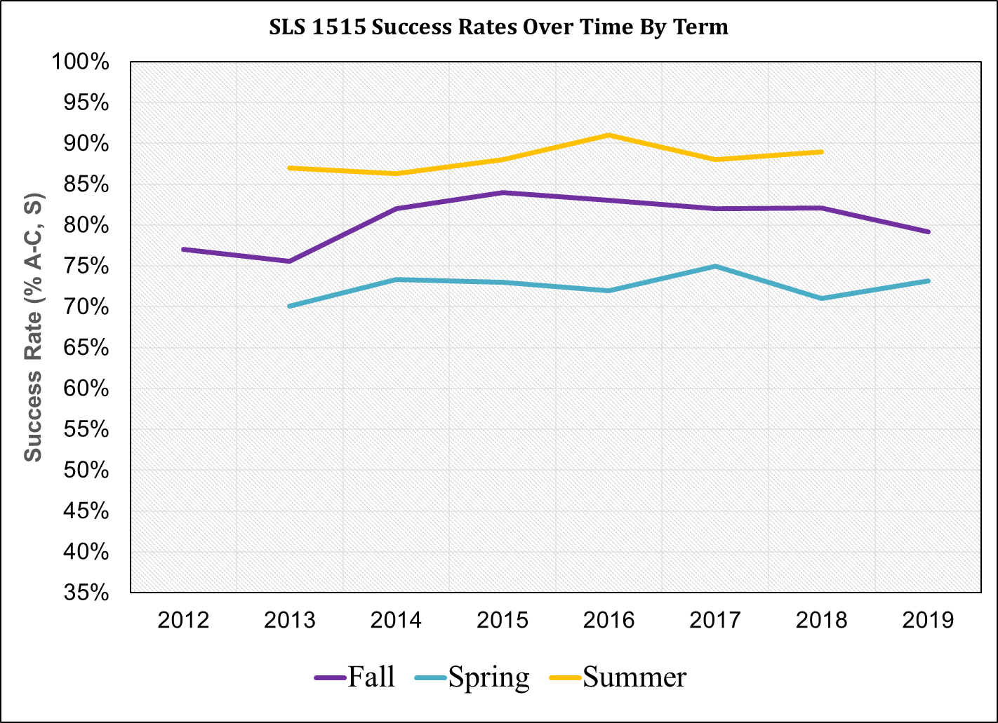
SLS 1515 – Success Rates
Points of interest:
In Fall 2019, the highest success rate stems from the Collier campus, just the 2nd time since the study began, and Charlotte exhibits the lowest, also just the 2nd time since the study began (both occurring in the two most recent terms.

Slide 3
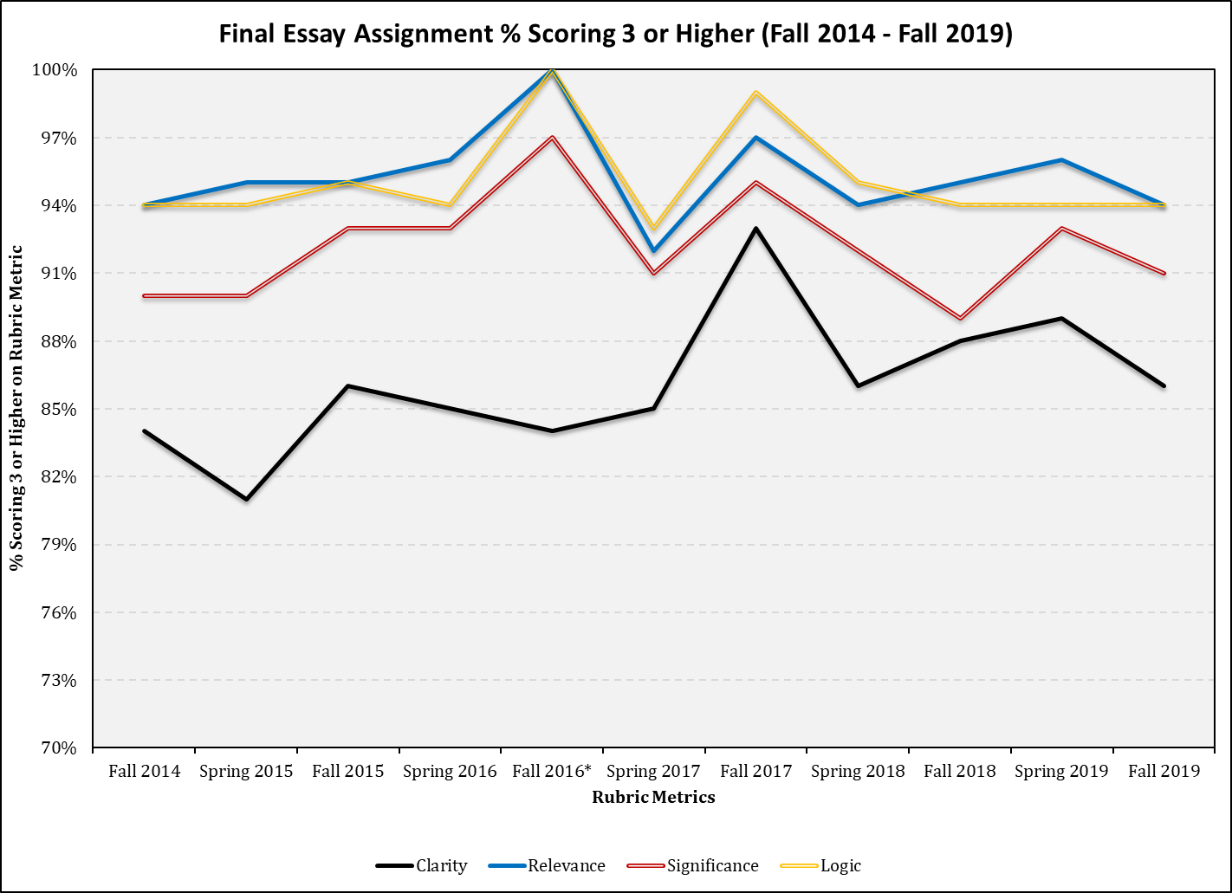
SLS 1515 – Achievement Measures
Points of interest:
For the group project, “Creativity” is consistently the lowest achieving of the rubric dimensions since the study began.
For the final essay, “Clarity” is consistently the lowest achieving in all terms since the study began.

Slide 4
SLS 1515 – Achievement Measures
Points of interest:
Like the final essay, for the CT Journal assignment, for the final essay, “Clarity” is consistently the lowest achieving in all terms since the study began.
Fall 2019 exhibits the 2nd lowest achievement since the study began.

Slide 5
SLS 1515 – Retention Studies
Points of interest:
Retention is 47.6% higher for those successful in SLS 1515 compared with those who are not successful in SLS 1515..

Slide 6
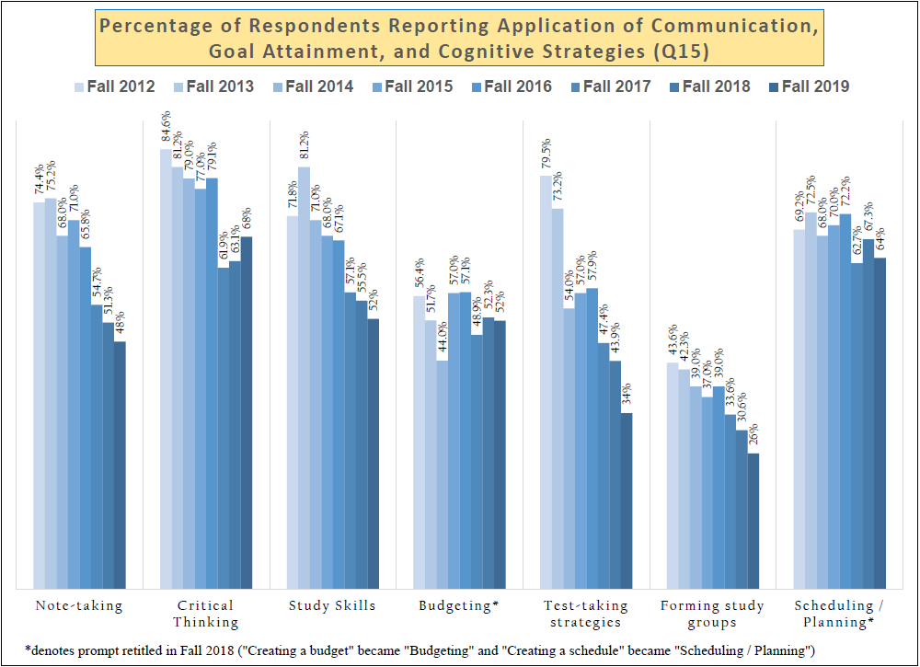
SLS 1515 – Success Strategies Survey Results
Points of interest:
“Using a calendar…” and “Working on large projects incrementally…” show steady increases in substantial improvement from 17%/22%, respectively, in fall 2012 to 31%/33%, respectively, in fall 2019.
At the same time, “Forming study groups” has reported consistent declines in application from 44% to 26%, while “Note-taking” has declined from 74% to 48%.

Slide 7
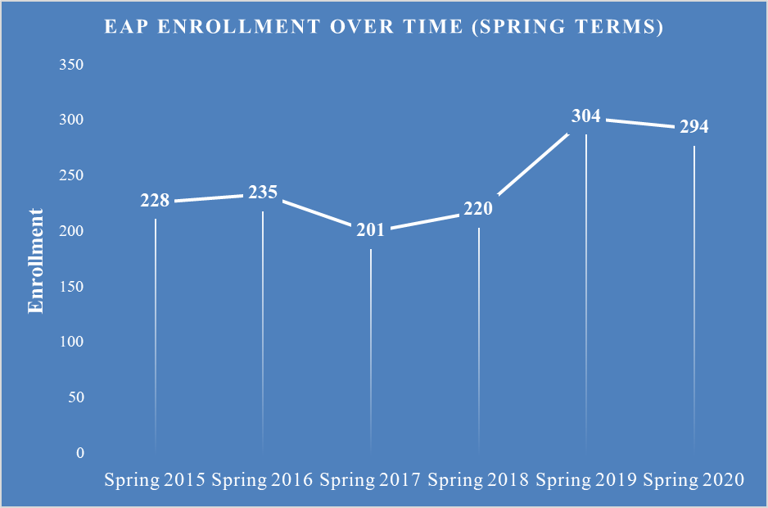
EAP – Enrollment
Points of interest:
In Fall 2019, enrollment climbs to its highest since Fall 2016.
In Spring 2020, enrollment is down slightly after a large jump in Spring 2019.

Slide 8
EAP – Success Rates in ENC 1101 via EAP/Direct
Points of interest:
ENC 1101 success rate via EAP 1640 entry is higher in 6 of 9 terms.
No terms exhibit statistically significantly different success rates between pathways into ENC 1101.

Slide 9
REA – Success Rates
Points of interest:
Overall success rates in Fall 2019 are the highest since Fall 2016.
Compressed learning strategy success rates in Fall 2019 are also the highest since Fall 2016.
Contextualized learning strategy success rates in Fall 2019 are the 2nd highest since the study began.

Slide 10
REA – Success Rates
Points of interest:
80% of students exhibit improvement from pre-test to post-test in REA 0019.
40% of students exhibit improvement of 10% or greater from pre-test to post-test in REA 0019.

