Slide 1
SCHOOL OF BUSINESS AND TECHNOLOGY
August 17, 2020
WELCOME BACK

Slide 2
Legal Disclaimer:
In light of the Corona Virus pandemic, this meeting is being conducted using Zoom and IS BEING RECORDED for required State meeting note-record purposes.
You do not need to show your video if you prefer – you can change your Zoom view at bottom left to hide yourself if you do not want to be recorded. Likewise, you are free not to use the chat function and/or to verbally comment.

Slide 3
AGENDA
Welcome & Introductions
5:30 – 5:50
General Update 5:50-6:10
Associate Dean Update
6:10-6:20
Chair Updates 6:20-6:40
Departmental breakouts
6:40-7:00
Thank you in advance for your flexibility and extra work since March and continuing!

Slide 4
INTRODUCTIONS
Picture Here
5:30 – 5:50
Name
Department and
Discipline (or course)
One thing you’ve done since the start of the pandemic in March
that you NEVER
thought you would do??

Slide 5
Rotary Club Luncheon
March 17, 2020
FSW School of Business and Technology
What’s going on in Business School?
Debbie Psihountas, Ph.D.
Dean, School of Business and Technology

Slide 6
SCHOOL OF BUSINESS AND TECHNOLOGY
WELCOME BACK
August 17, 2020
Building from Disruption

Slide 7
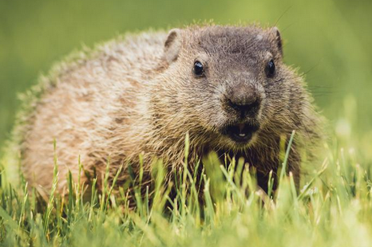
Dean Update Dr. Debbie Psihountas
Picture Here
Announcements
Scheduling updates
And Modalities
Grants and other
funding
Tutoring Services
Social media updates
Q&A

Slide 8
Announcements
Picture Here
Busy week – many learning opportunities through the TLC this week – See TLC Calendar on FSW Homepage for complete listing:
https://www.fsw.edu/trainingcalendar/display
New Architecture and Construction Technology Professor – John Montoya

Slide 9
Tune in – 11:30 to 12:15 this Friday

Slide 10
5:50-6:10 Updates, continued
Picture Here
Scheduling updates
And Modalities
Grants and other
Funding
Social media updates
Questions?

Slide 11
SOBT Social Media
ghghgghghdfdgffgfgffgf
BusinessTechno9 | TWITTER handle
FSWSOBT | Instagram
FSWSOBT | LinkedIn
FSW School of Business and Technology | Facebook
SBT@fsw.edu | Email for web inquiries
ExcitingnewsfromSOBT@fsw.edu | Marketing campaign email

Slide 12
Associate Dean Update Jennifer Baker 6:10 – 6:20
Picture Here
Syllabi
Tutoring Services
Other Updates

Slide 13
Chair Updates 6:20-6:40
Picture Here
Business & Management
Dr. Jennifer Patterson
Computer and Network
Technology
Dr. Roger Webster
Criminal Justice and Public
Safety
Dr. Richard Worch
Legal Studies, Architecture,
Construction, and Engineering
Dr. Mary Conwell

Slide 14
Q & A
DEPARTMENT BREAKOUTS
Thank you for coming
Regular monthly meetings 1 pm Second Friday of each month
Join Us!

