Slide 1
What is Truth-Seeking?

Slide 2
Truth-Seeking is
1. searching for the best possible understanding of any given situation 2. despite what you may uncover, and 3. being willing to challenge and perhaps even change your opinions based on what you discover.

Slide 3
What is Truth?

Slide 4
Truth is
“The quality of being true” (“Truth,” 2010).
True: “Of a statement or belief: Consistent with fact; agreeing with the reality; representing the thing as it is. (“True,” 2010).
Fact: “That which is known (or firmly believed) to be real or true; what has actually happened or is the case; truth attested by direct observation or authentic testimony; reality. (“Fact,” 2010).

Slide 5
What is Objectivity?

Slide 6
Objectivity is
“the ability to consider or represent facts, information, etc., without being influenced by personal feelings or opinions.” (“Objectivity,” 2010).

Slide 7
What is Bias?

Slide 8
Bias is
“an inclination, leaning, tendency, bent; a preponderating disposition or propensity; predisposition towards; predilection; prejudice” (“Bias,” 2010).

Slide 9
What is Prejudice?

Slide 10
Prejudice is
“Preconceived opinion not based on reason or actual experience; bias, partiality; (now) spec. unreasoned dislike, hostility, or antagonism towards, or discrimination against, a race, sex, or other class of people.” (“Prejudice,” 2010).

Slide 11
What is an Agenda?

Slide 12
An Agenda is
“the underlying intentions or motives of a particular person or group” (“Agenda,” 2010).

Slide 13
What Role does Truth-Seeking Play in Research?

Slide 14
Truth-Seeking Involves
Research: Locating, selecting, and using information that may not support your opinions or beliefs.
Research: Considering multiple perspectives, biases, agendas, perspective, context, depth, scope, and critical thinking
Truth-Seeking requires you to ask hard questions of your resources, and to strive to objectively select and use them.

Slide 15
How do I Critically Evaluate Information/Truth-Seek?
Consider the content
Consider the author
Consider the sponsor: publisher, sponsoring organization
.com/.net vs. .gov/.edu
Magazines & newspapers vs. scholarly journals
Books published by a university press or major publisher vs. a vanity press
Question Authority!

Slide 16
Why is Critically Evaluating Information & Truth-Seeking Important?
As students you are scholars
Take pride in your work
Avoid academic errors
Avoid life errors
Information empowers
Knowledge empowers

Slide 17
Truth-Seeking Exercise

Slide 18
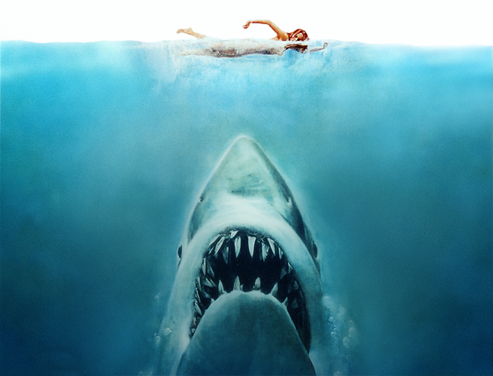

Slide 19
Beach Scene from Jaws

Slide 20
What misconceptions do you think Jaws generated about sharks?

Slide 21
In what ways do you think Jaws damaged the shark population?

Slide 22
In what ways do you think Jaws benefited the shark population?

Slide 23
Shark Week Debunked

Slide 24
References
Agenda. Bias. Fact. Objectivity. True. Truth (2010). In A. Stevenson (Ed.), Oxford dictionary of English (3rd ed.). Retrieved from http://www.oxfordreference.com
The Ocean Portal Team, The Smithsonian National Museum of Natural History (2015). Sharks. Retrieved from http://ocean.si.edu/sharks
Lovgren, S. (2005, June 15). "Jaws" at 30: Film stoked fear, study of great white sharks. National Geographic News. Retrieved from http://news.nationalgeographic.com/news/2005/06/0615_050615_jawssharks.html

