Slide 1
Stu-Jitsu:The Gentle Art of Managing Student Workers
Mark H.X. Glenshaw, Daytime Services Manager,
Jack C. Taylor Library, Fontbonne University,
St. Louis, Missouri

Slide 2
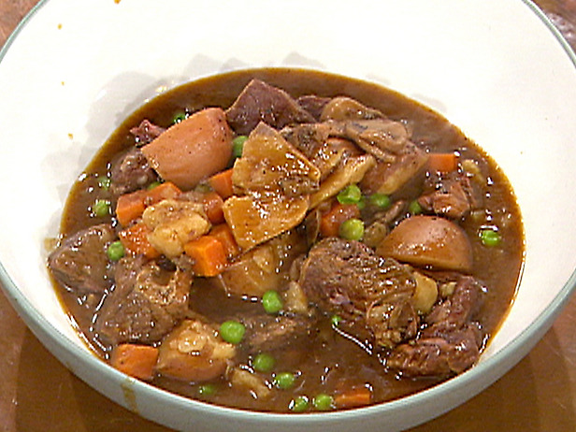

Slide 3
Title Inspiration
The martial art jiu-jitsu. Originated in Japan, honed in Brazil and means “the gentle art”
An unflashy martial art but an exceptionally effective one
Like jiu-jitsu, supervising student workers does not require flashiness but it rewards effectiveness
To learn more about jiu-jitsu, watch the David Mamet film “Redbelt”

Slide 4
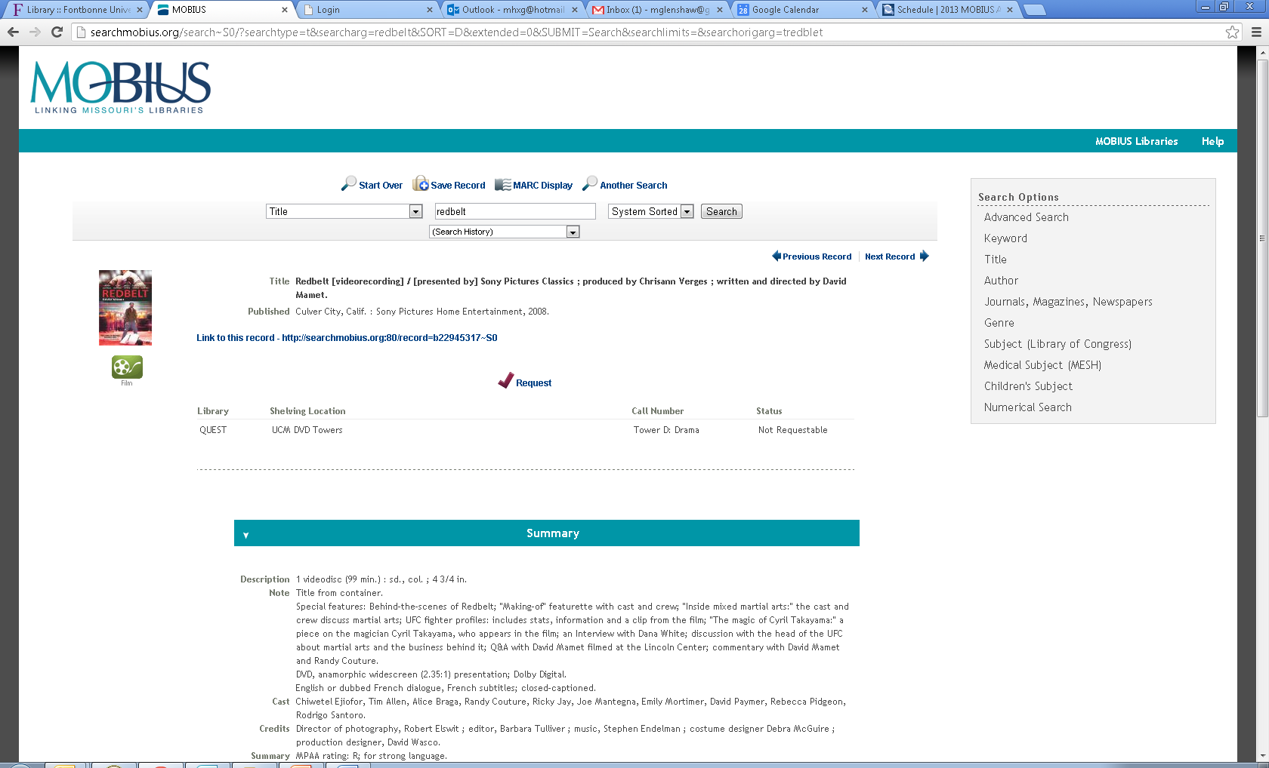

Slide 5
My Background: Contexts and Experience
Healthy amount of retail experience both in excellent video and music stores
Supervising 6-10 shelvers at the Central Library of the St. Louis Public Library system after starting as a shelver
Supervised 8-10 student workers providing AV and IT support for The George Warren Brown School of Social Work at Washington University in St. Louis
Supervised 20 plus student workers at Pius Library at St. Louis University
Supervising 7-8 student workers at the Jack C. Taylor Library at Fontbonne University

Slide 6
Before Going Too Far Down The Rabbit Hole-A Few Notes
A lot of humility goes a long way
I do not pretend to have all the answers or that I am the perfect student worker supervisor 24-7
This is not a one-size-fits-all model or solution
These are tips, insights, philosophies, and practices that can help
Make your students an even more effective part of your library’s staffing
Make your students a value added work force
Prepare your students for the working world

Slide 7
Hiring-Where It All Begins
Quality In, Quality Out
Selectivity goes a long way
A pulse, a spinal column and a heartbeat do not a qualified candidate make
In the interview let them know clearly what is expected of student workers in terms of tasks, performance and role

Slide 8
Hiring-Where It All Begins
Look for:
Customer service experience and orientation
Energy
Communication skills
Intellectual Curiosity
Look for someone that you would want to encounter as a patron
Know when to err on the side of filling gaps in your schedule. If mistakes occur, own them

Slide 9
“Inheriting” Student Workers
Find out as much as you about them from previous supervisors and colleagues
Learn their strengths, experiences and weaknesses
Meet with them, learn about them and let them learn about you

Slide 10
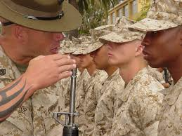
You Have A Team of Student Workers-Now What?
Before you begin a model to consider:
The military model which stresses:
Accountability
Responsibility
No task is too small
The rules apply to everyone

Slide 11
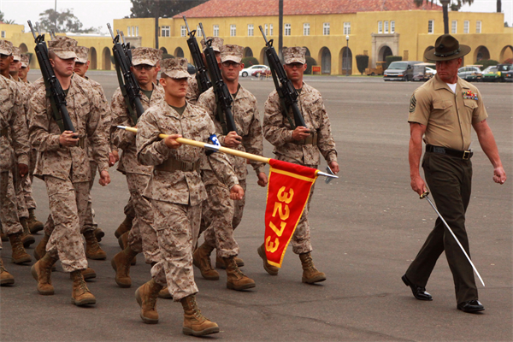
You Have A Team of Student Workers-Now What?
The military model which stresses:
Pride in work
Mentoring
Standard Operating Procedures
Chain of Command

Slide 12
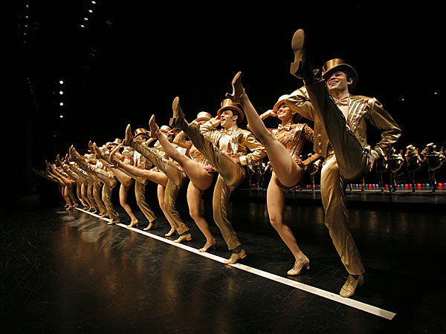
You Have A Team of Student Workers-Now What?
A model to avoid:
The “chorus line” model which is:
Upper management kicks middle management, middle management kicks lower management, lower management kicks student workers
This model produces such welcome results as:
Resentment and poor morale in all ranks
A “That’s not my job.” mentality
Chaos, confusion and crisis.
Good times.

Slide 13
The First Day and Week
Help the institution learn about them
Getting to know you
Send out an e-mail before their first shift with information about the student including:
Major
Hometown
student activities
a photo
some unique and interesting aspects of the student

Slide 14
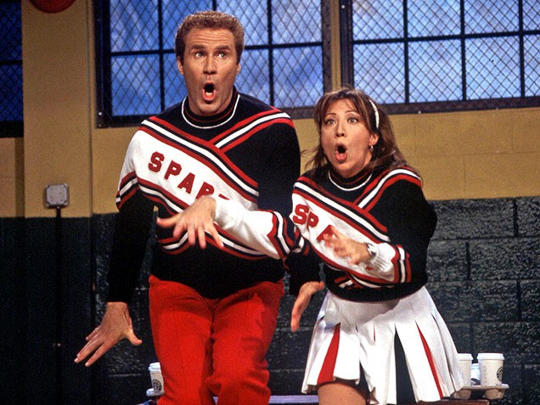
The First Day and Week
Help them learn the institution
Introduce Yourself
Walking tour
Hit high points and touch on the nitty-gritty without overwhelming with detail
Show and explain the org chart
Have them meet and read about the people with whom they will be working-putting faces to names and positions
Show them where to hang their coat, put their lunch; etc.
Make amenities available to them even when they are not working
“Membership has its privileges”

Slide 15
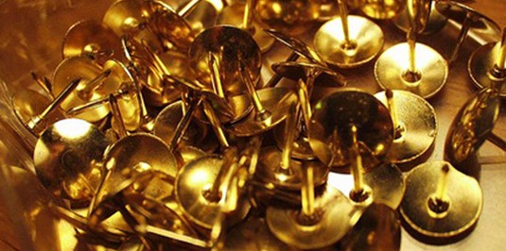
Getting Down To Brass Tacks
Go through the procedures manual
Hit high points and touch on the nitty-gritty without overwhelming with detail
Stress communication
Get contact information
Provide contact information
Who, What, When, Where, How and Why?
Give examples

Slide 16
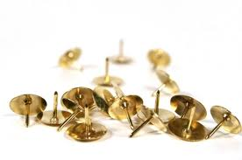
Getting Down To Brass Tacks
Have them watch and learn a process and then try it themselves:
Narrate and explain as you do a task
In ways both subtle and obvious-be the exemplar, the paragon
The next time the task comes up-have them do it
Start to throw them in the deep end but give them floaties
Be alert for teachable moments
Briefly review with them what they have done at the end of their first shifts

Slide 17
Getting Down To Brass Tacks
Along the way impart key philosophies and practices such as:
Crawl, walk, run
Learning never stops nor do expectations
Do not be shy about asking questions

Slide 18
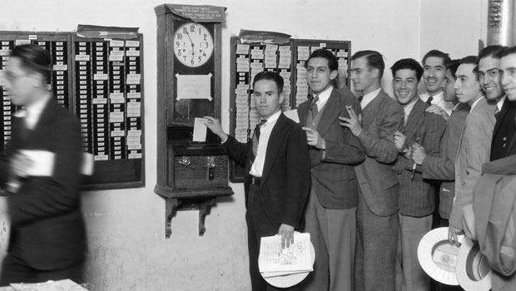
Day In, Day Out
Be there when they arrive, greet them, let them get settled and brief them on:
what is going on that day
what things are going well/not so well
Ask how they are doing and keep appraised of their:
Academics
Interests/Plans
Health
Personal Life (as appropriate)

Slide 19
Day In, Day Out
Have a plan of what they will be doing
It doesn’t have to be some grand scheme but just an overall idea of their activities for the shift
Share the plan with them
Make yourself as available as possible for:
Questions and Training
If you are not available-let them know where you will be and who they contact in the meantime
When they are ready to leave:
Review anything that needs such attention
Thank them for their help and work.

Slide 20
Shelving – The Great Challenge
Shelving-one of the most important tasks in a library but often one of the least favorite to be done
Stress shelving’s importance
A book is useless if cannot be found
Appeal to a variety of motivations
Selfish
Altruistic
Institutional Pride
Train and Check Thoroughly
Show tips from your experience
Crawl, walk, run
Demonstrate that you have had shelved, do shelve and will shelve
Plant seeds that may have them come to enjoy shelving

Slide 21
Teaching Multiple Technologies
First a word of caution-just because they are students and generally younger does not mean they are all super tech-savvy
Get a baseline of the their technology knowledge and experience
Start with the basics
What the equipment or software does and how it works
the basic functions
The common/frequent problems
How to troubleshoot and fix these problems

Slide 22
Teaching Multiple Technologies
Stress first principles
Demonstrate where/when things work logically and when things do not
Crawl, walk, run
Let them know when/where they should ask for help
Progressive learning
Keep teaching them additional skills and nuances by building on the basics
If they have the aptitude, let them run with the ball
If they need more time, take the time but while stressing that this must be mastered

Slide 23
Transitioning to New Technologies
Emphasize the empathize-we are all in the same boat
Learn as much as you can beforehand
Provide training opportunities and in multiple contexts (classroom, webinars, self-directed learning, pre-release demos, etc)
Some transitions are easier than others
Millennium to Sierra easier than the switch from Office 2003 to Office 2007
Highlight continuities and easy transition points when available

Slide 24
Disciplining Students
With any luck very little disciplining will need to occur thanks to good hiring, training and setting of expectations
That said…
Let them know how your “strike system” works
Be fair but be firm
Avoid disciplining the group because of a bad apple or two
Consult with your supervisor as needed

Slide 25
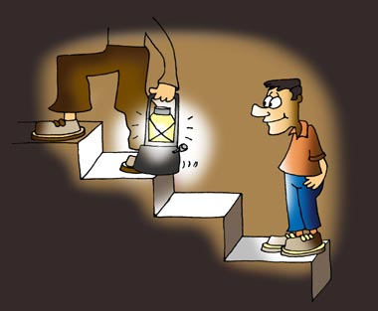
Be A Resource For Your Students
Help them navigate the academic and administrative maze that college can be
Share your knowledge of your city and the state you are in with your students
Guide them in their professional development
Dress
Correspondence
Verbal communication
Become a reference for them and hopefully they will endorse you
Many of us are LinkedIn
Happy student workers helps your library and your institution
Encourage, caution, challenge, inspire and motivate them

Slide 26
Stu-Jitsu:The Gentle Art of Managing Student Workers
Thank you for your time and attention
Questions?

