Slide 1
Qualtrics Introduction
Steven Kolberg Bianco & Erin Hailstone
December 7th, 2015
Notes:
Signing up for/accessing Qualtrcis (if they have not done so)
Survey creation
Survey collaboration**
Changes
Reporting
Qualtrics University/Help

Slide 2
Agenda
Logging In/Creating an account
Building Your Survey
collaborating
Making changes
Reporting
Qualtrics university (help)

Slide 3
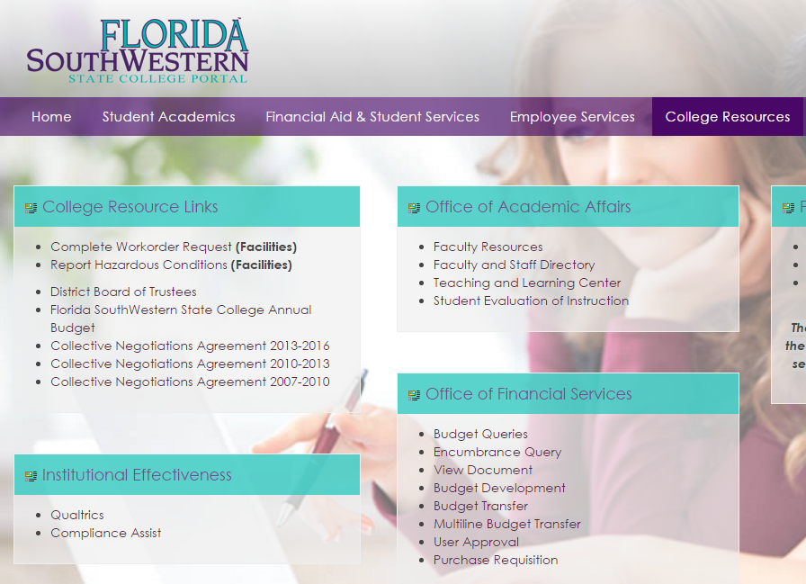
Logging into Qualtrics
#1.
Two methods of access:
Directly at https://fsw.qualtrics.com/ OR
Within the Portal under the “College Resources” tab
#2.

Slide 4
Logging into qualtrics (cont’d.)
If it is your first time logging in, you will need to create your profile with your first & last name with your email address.

Slide 5
Creating surveys - wwwwh
Who?
Who is your target audience?
What?
What information/data are you looking to utilize/solicit?
Where?
Where will you collect your feedback?
When?
When will you distribute your survey?
How?
How are your results going to be utilized?
Notes:
Handout of question types from http://www.qualtrics.com/university/researchsuite/basic-building/editing-questions/question-types-guide/
Hands-on with the software suite.

Slide 6
collaboration
Make sure to share your surveys to others within your functional area.
Supervisors should make sure they have access to the surveys of their employees.

Slide 7
Changing questions
If the survey is held annually or frequently, be careful not to change the content of the question drastically. This can make year to year comparisons of the data difficult.
Making a copy of an existing survey is quite easy, and a good way to reuse the same survey for a different time period.

Slide 8
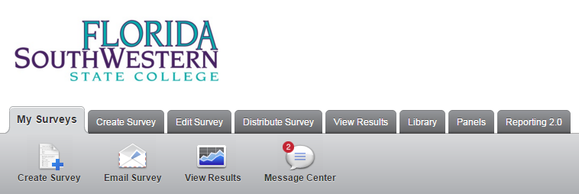
Reporting

Slide 9
Reporting (cont’d.)
Default styles create very functional reports of the data acquired from your survey.
Reports can be exported as a pdf, word document, powerpoint, and others

Slide 10
Qualtrics university (help)
http://www.qualtrics.com/university/researchsuite/

