Slide 1
Multimedia on Ovid
July 2013

Slide 2
We Know You Need & Want Multimedia
Our customers tell us they want to use multimedia:
In Research
To learn about a research study offering new insights into a treatment
In Practice
To find information that helps advance the diagnosis and management of a medical condition
As residents, to find videos to prepare for a new clinical rotation
As Educators
To engage medical students in creative and interactive ways
To help students gain a better understanding of the underlying
disease by using video case simulations
On the Go
Simply to stay current in between meetings or seeing patients by watching videos

Slide 3
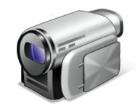
Staying Current is More Than “Reading”
Staying current also means…
Watching
Viewing
Listening

Slide 4
Multimedia-Centric Research, Practice & Education
Ovid Does More Than Ever Before!
Visual diagnosis & treatment
Learn and review procedures and techniques
On-demand thought leadership
In-depth article discussions
Remote and virtual classroom materials
Flexible approach to medical education, research and practice
Multimedia is great for librarians and information specialists, educators and students AND staff at the point of care including physicians, clinicians, nurses, allied health, and residents

Slide 5
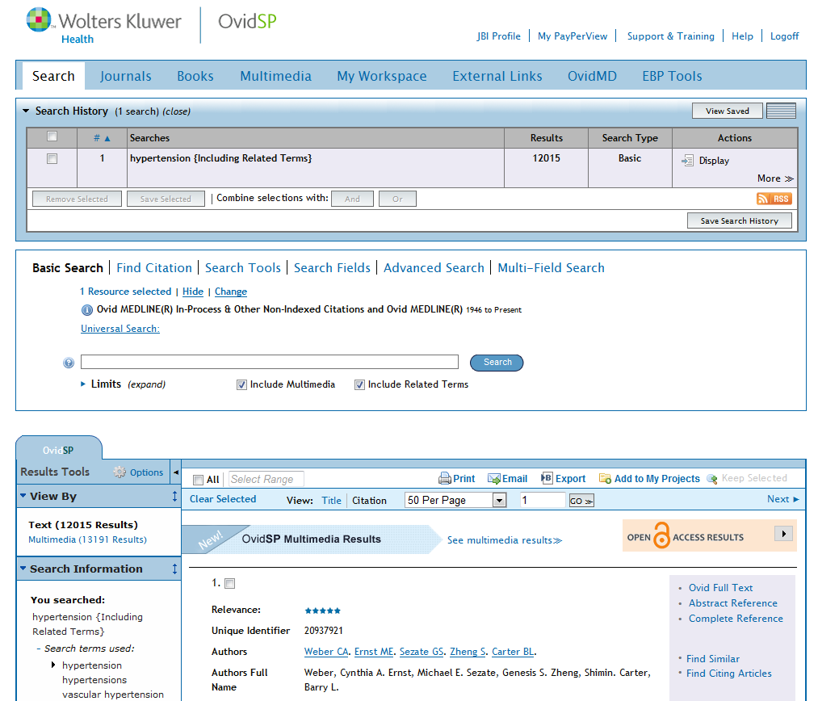
Adding Multimedia Without Changing How You Work
Easy Access.
Flexible.
Relevant.

Slide 6
Flexible to Support Various Users
Or use keyword or field search in Advanced Search when you need to rely on Ovid’s renowned precision search
For users who prefer to search using keywords, use Basic Search to quickly find relevant multimedia
Notes:
-

Slide 7
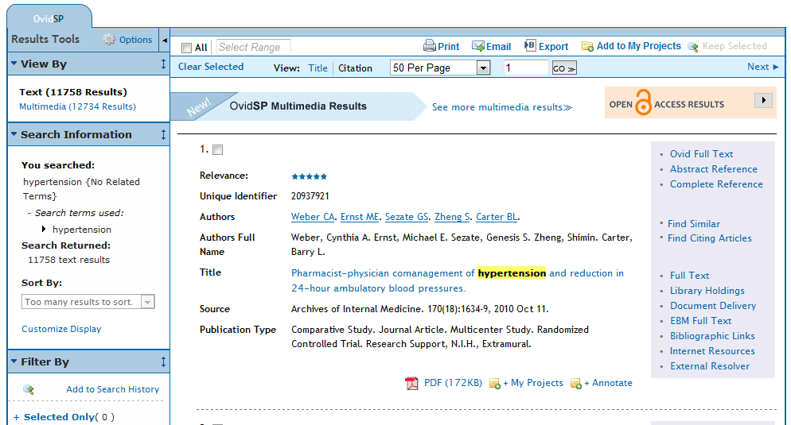
Easily Access Multimedia Through Your Results
Quickly access your multimedia results at the top
It’s your choice; easily switch between “Text” and “Multimedia” results

Slide 8
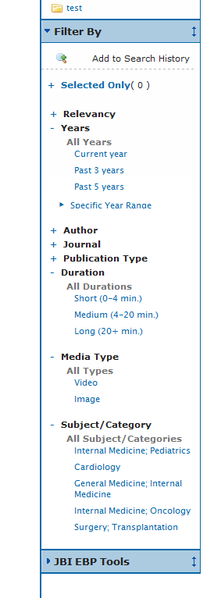
Filters mean Flexibility
Maximize your search by utilizing filter options to narrow your results
Do you prefer information from the latest issue? Or do you need an extended reference?
Can you spend your lunch hour? Or do you only have a quick 5 minutes?
Are you a visual learner? Or do you want to multi-task?
Are you looking for something specific?
Notes:
-

Slide 9
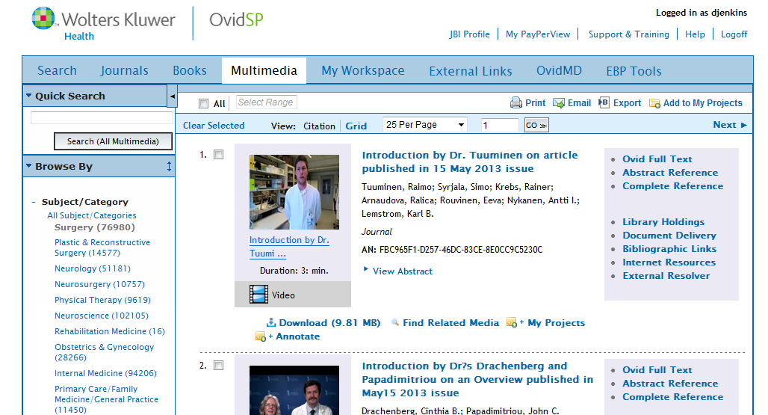
“Browse” Multimedia
If you prefer, browse through available multimedia ….
… while maintaining easy access to full text
And find something in your specialty

Slide 10
Robust Media Player
Download it to your computer or add it to your projects
Like what you saw? Check out the other videos found in this article

Slide 11
Use OvidSP to Power Multimedia Searches
Existing OvidSP capabilities can be used with multimedia.
Print, Email, and Export multimedia citations
Add multimedia and searches to My Projects
Download video and image assets
NEW! The OvidSP multimedia player has an embedded gallery for viewing related videos and images.

Slide 12
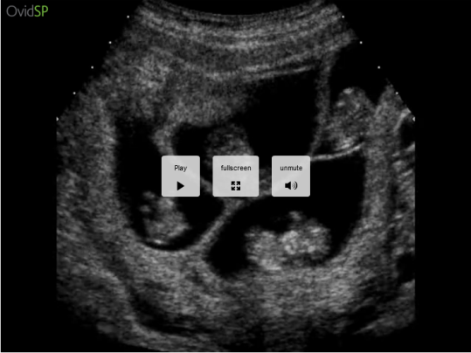
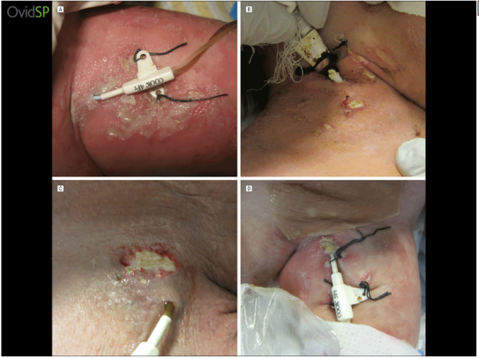
How could you use Ovid multimedia in clinical practice and education?
Search for Skin Grafts and watch a video on how to harvest a skin graft from the scalp
Search for Waterjet Dissection in Neurosurgery and see a 3-part video showing you step-by-step instructions of this procedure within the brain
Watch an ultrasound of quadruplets at 10 weeks
View images of contact dermatitis caused by catheter dressings

Slide 13
Only Relevant Content
Ovid multimedia gives you access to millions of multimedia assets from key partners including Lippincott Williams & Wilkins (LWW)
Over 1800 videos from books and journals of procedures, article discussions, and diagnosis & treatment techniques
Millions of images from trusted books and journals on OvidSP
Plus! Coverage across several specialties including Nursing, Neurology, Surgery, Physical Therapy, OB/GYN, Cardiology and more!

Slide 14
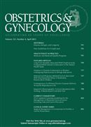
Highly-Ranked, Multimedia-Rich Titles
Offer institutional access to hundreds of multimedia resources across many key titles!
2012 Impact Factor: 3.535*
Ranked #13 in Surgery
2012 Impact Factor: 4.798*
Ranked #2 in Obstetrics & Gynecology
2012 Impact Factor: 3.568*
Ranked #37 in Surgery
*Visit 2012 Journal Citation Reports® (Thomson Reuters, 2013) – http://wokinfo.com/products_tools/analytical/jcr/ – for
additional information on Impact Factor, 5-year Impact Factor, Citable Items, Eigenfactor® Score and Article Influence® Score

