Slide 1
SCHOOL OF BUSINESS AND TECHNOLOGY
Advisory Board Meeting
OCTOBER 27, 2020
12:30-1:30 pm H118 and Virtual
Happy Halloween!

Slide 2
AGENDA
Picture Here
Agenda and Covid update
Update on Programs
Grants Update
Promotion and Marketing events
New job-seeking events
Enrollment – summer and fall
Next meeting items and Close

Slide 3
Covid 19 Update
Picture Here
March 24 meeting canceled due to school’s closure in mid-March

Slide 4
Program Update Business Department
Picture Here
New AS in Business Administration and Management track this fall:
Entrepreneurship Track

Slide 5
Program Update Computer Science Dpt
Picture Here
Based on feedback from new faculty, Computer Science advisory board, and leadership of the new chair (since January, Dr. Mary Myers), extensive resequencing of courses underway.

Slide 6
Program Update Legal Studies, Architecture, Construction, & Engineering
Picture Here
New CCC – College Credit Certificate in Paralegal Real Estate started in fall 2020

Slide 7
Program Update Criminal Justice, Crime Scene Tech, Public Safety
Picture Here
Significant enrollment growth in Crime Scene Technology
Search underway for new CJ/PAD faculty to join in January (or next fall) – Professor Mike Nisson is retiring in December

Slide 8
Grants Update
Picture Here
Schulze Foundation
CARES Grant

Slide 9
Promotion and Marketing Events
Picture Here
SOBT made significant headway over the summer with outreach to students

Slide 10
Job Seeking Events
Picture Here
Unemployment in SWFL

Slide 11
Enrollment: Summer and Fall
Picture Here
SOBT was the only school in summer term of the 5 schools at FSW that had growth in year-over-year enrollment from the prior summer
Fall has continued successfully – responded quickly with new choices for students. We have been up close to 4.8% over our Fall 2019 numbers all fall term
Have surveyed students – trying our best to be responsive during these trying times

Slide 12
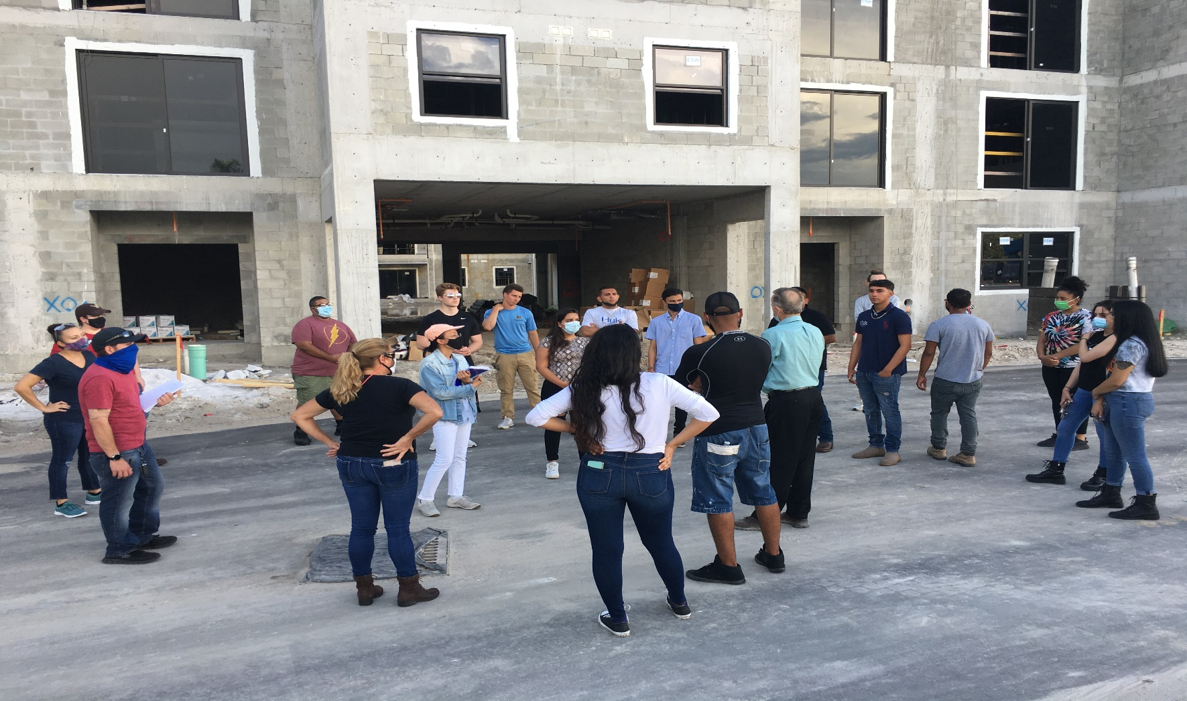
Other: Miscellaneous Field Trips in Architecture/Construction New “West End at Citywalk” Job Site

Slide 13
Next Meeting Items and Close - Thank you for coming!
Picture Here
Open Discussion
Next Meeting: Spring 2021

