Slide 1
Academic Success Data for Department Meeting August 18,2015

Slide 2
Developmental Reading Data

Slide 3
Student Enrollment Data- Developmental Reading
Source: Local Banner Data (Open Close Report)

Slide 4
Enrollment Tracking

Slide 5
Section Tracking

Slide 6
Reading Course Success Rates

Slide 7
REA 0019-Mastery Exam/Common Assessment
Options for reporting achievement
% of student receiving a minimum pass score (e.g. 70%)
% of students receiving scores at or above certain benchmarks (e.g. 50%, 70%, 90%)
Scores by competency
Overall mean scores

Slide 8
REA 0019 Final Exam Results

Slide 9
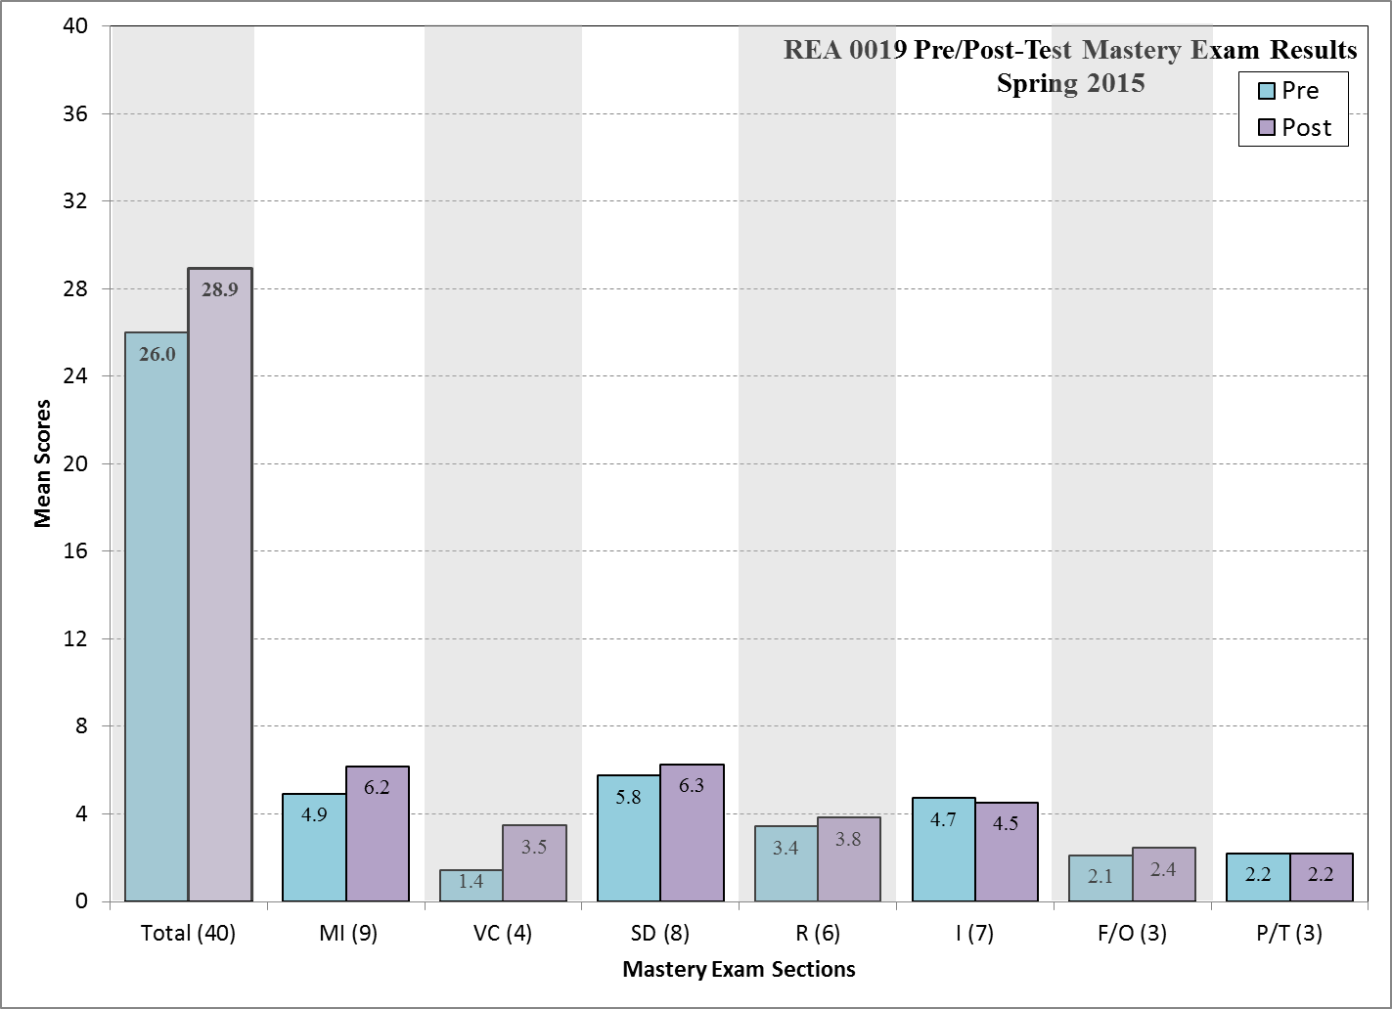
REA 0019 Final Exam Results
The department shifted to a new exam in spring 2015. Fall 2014 data is not a relevant comparison.

Slide 10
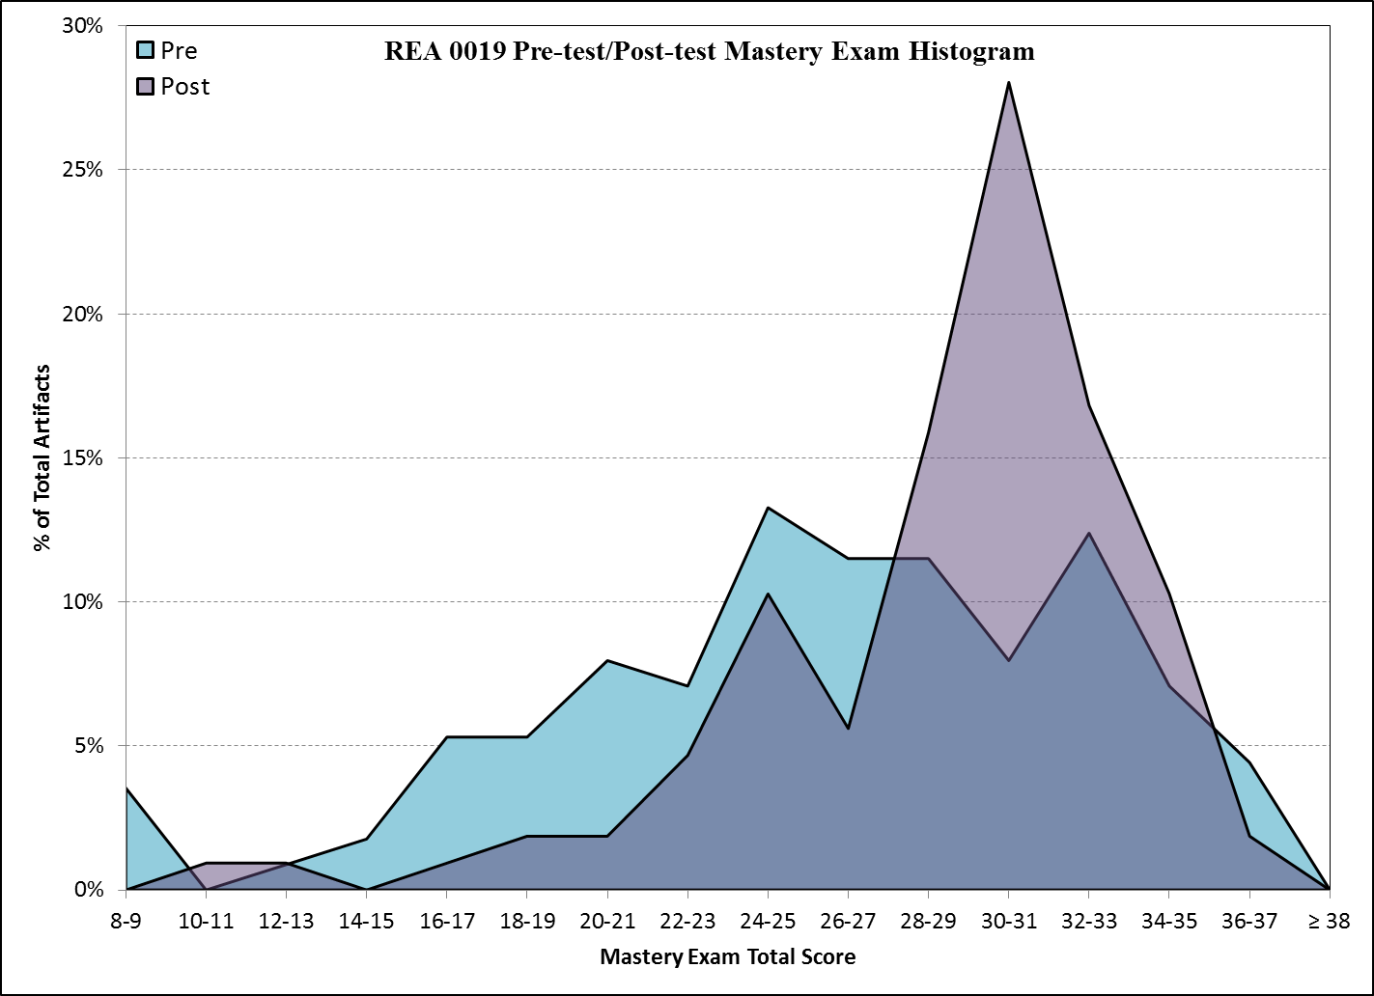
REA 0019 Final Exam Results

Slide 11
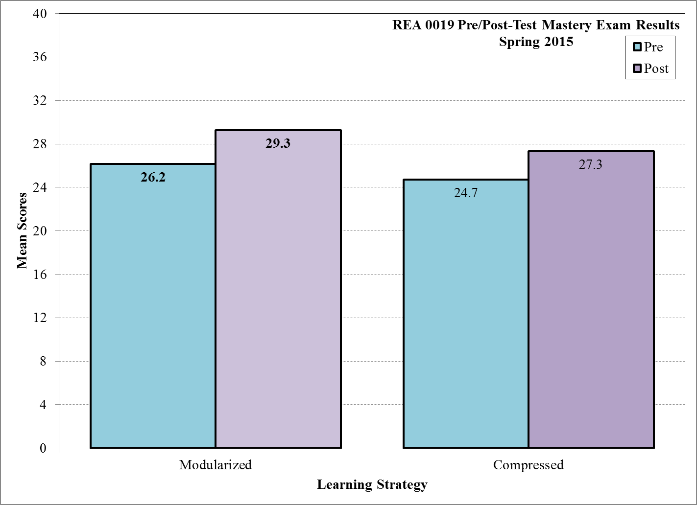
REA 0019 Final Exam Results

Slide 12
Developmental Reading Satisfaction Survey Results
SB 1720 Implementation

Slide 13
EAP Data

Slide 14
Enrollment Tracking

Slide 15
Common Course Assessment EAP1540

Slide 16
Common Course Assessment EAP1640

Slide 17
EAP Course Success Rates

Slide 18
EAP Satisfaction Survey
SB 1720 Implementation

Slide 19
SLS Data

Slide 20
Success Strategies Survey

Slide 21
Success Strategies Survey

Slide 22
Success Strategies Survey

Slide 23
Success Strategies Survey

Slide 24
Success Strategies Survey

Slide 25
Success Strategies Survey

Slide 26
Success Strategies Survey

Slide 27
Spring 2015 Focus Groups Highlights
As in past focus groups, students discussed time management strategies as important and useful course topic.
Another widely discussed topic was how the course encouraged students to “talk” or “communicate” with other students.
Students were very positive about Peer Architects.
As in past focus groups, students reported learning about themselves to include thorough use of the personality and aptitude assessments.
As in past focus groups, students mentioned critical thinking as an important and useful course topic.
GPS was the most mentioned assignment (mostly positive, any negative comments related to difficulty to fit into life schedule).

