Slide 1
Learning Assessment Committee Updates
Presentation for the Provost/VPAA Meeting August 18th, 2015

Slide 2
Mission Statement
Florida SouthWestern State College is focused on advancing student learning at the course, department/program, and institutional levels. The assessment of student learning, the interpretation of the results of assessment, and the use of those findings requires the participation of the students, faculty, administrators and staff individually and collectively. At Florida SouthWestern State College, these stakeholders engage in assessment to inform improvement, measure achievement, and make curricular and programmatic decisions in a continuous cycle of data-driven innovation.

Slide 3
Committee Charge
The Learning Assessment Committee is charged with developing and recommending procedures and best practices that provide the college with measureable data to assess student learning. The Learning Assessment Committee will assist academic disciplines to develop plans for assessment strategies, rubrics, and methods for using data to make changes in the delivery of course material to promote student success through the following actions:
Make formal recommendations on the best practices for data collection, assessing results, and making changes to promote student success in General Education.
Make formal recommendations on the best practices for data collection, assessing results, and making changes to promote student success in academic disciplines.
Work with the Division of Teaching Innovation, Professional Faculty Development Committee, and Online Learning to develop training for all faculty in implementing assessment strategies, developing and using rubrics, and making course modifications.
Serve as individual faculty committee members as their discipline’s assessment liaison and has responsibility to keep the department involved in the assessment process.

Slide 4
Lac Membership – 2014-2015
Position Vacant (Business & Tech)
Richard Worch (Public Safety Management) – Lee
Colleen Moore (Nursing) -- Collier
Caroline Seefchak (Education) – Lee
Marty Ambrose (English) -- Lee
Amy Trogan (English/Chair) – Lee
Stuart Brown (Fine Arts) – Lee
Fernando Mayoral (Foreign Languages) – Lee
Tom Donaldson (Social Sciences) – Charlotte
Sarah Lublink (Humanities) – Lee
Jane Charles (Library) – Lee
Katie Paschall (Speech) – Collier
Eric Seelau (Social Sciences) -- Lee
John Meyer (Business & Tech/Dean) – Lee
Don Ransford (Math) - Lee
Peggy Romeo (Natural Sciences) – Lee
Ron Smith (Math) – Lee
Barbara Miley (Institutional Effectiveness) - Lee
Joe van Gaalen (Assessment Director)
Eileen DeLuca (Associate Vice President of Academic Affairs)

Slide 5
Assessment Coordinators 2014-2015
Richard Worch (Public Safety Management) – Lee
Amy Trogan (English/Chair) – Lee
Fernando Mayoral (Foreign Languages) – Lee
Tom Donaldson (Social Sciences) – Charlotte
Sarah Lublink (Humanities) – Lee
Jane Charles (Librarian) – Lee
Katie Paschall (Speech) – Collier
Peggy Romeo (Natural Sciences) – Lee
Ron Smith (Math) – Lee
Caroline Seefchak (Education)-Lee

Slide 6
2014-2015 Course-Level Assessment Plan
For AY 2014-2015, the Office of Academic Assessment will provide support to faculty to develop assessment tools, administer assessments, collect data, and analyze results for
Courses that are offered in all three modalities (campus-based, online, dual enrollment)
SB 1720 Courses (MAT 0057, ENC 0022, REA 0019)
The QEP course (SLS 1515)
The following courses will be assessed with goals, results, and use of results entered into Compliance Assist.

Slide 7
Course Level Assessment 2014-2015
Social Sciences | English
AMH 2010 | ENC 0022
AMH 2020 | ENC 1101
PSY 2012 | ENC 1102
Science | Academic Success
BSC 1010 | SLS 1515
BSC 1010L | REA 0019
Speech and Foreign Languages | Mathematics
FRE 1120 | MAC 1105
FRE 1121 | MAC 1114
SPC 2608 | MAC 1140
SPN 1120 | MAT 0057
SPN 1121
Humanities | Education
HUM 2211 | EDF 2005
HUM 2235 | EDF 2085
HUM 2510
Business and Technology
GEB 1011

Slide 8
Course Level Assessment
Our website is a great resource for staying current in our assessment practices.
http://www.fsw.edu/facultystaff/assessment/index

Slide 9
Course-Level Assessment Reporting
August 28^{th –} The 2014-2015 results must be completed in Compliance Assist.
Discuss your upcoming course level assessment plan at your next department meeting.
September 26th - New goals must be entered
Use of Results and Plan for Sharing.
Last year’s results + Upcoming year’s goals = Closing the loop
Compliance Assist is challenging since it is not regularly utilized.
Dr. van Gaalen is happy to help your department through this process.

Slide 10
Course-Level Assessment 2015-2016
For AY 2015-2016, the Office of Academic Assessment will provide support to faculty to develop assessment tools, administer assessments, collect data, and analyze results for:
Courses that are offered in all three modalities (campus-based, online, dual enrollment).
SB 1720 Courses (MAT 0057, ENC 0022, REA 0019).
The QEP course (SLS 1515).
Other courses identified to rotate through the course-level cycle.

Slide 11
Course-Level Assessment 2015-2016
Social Sciences | Humanities/Fine Arts
AMH 2010 | HUM 2211
AMH 2020 | HUM 2235
PSY 2012 | HUM 2250
DEP 2004 | PHI 2010
ECO 2013 | PHI 2103
POS 2041 | PHI 2600
 | REL 2300
Science | Education
BSC 1010-1010L | EDF 2005
BSC 1011-1011L | EDF 2085
BSC 1050C-1051C | EME 2040
Speech and Foreign Languages | Mathematics
FRE 1120 | MAC 1105
FRE 1121 | MAC 1114
SPC 1017 | MAC 1140
SPC 2608 | MAT 0057
SPN 1120 | MAT 1033
SPN 1121
Academic Success | Health Professions
SLS 1515 | HUS 1400
REA 0019 | CVT 2842
EAP 1640 | NUR 4827-4827L
Business and Technology | English
GEB 1011 | ENC 0022
CGS 1000 | ENC 1101
CGS 1100 | ENC 1102
MAN 2021

Slide 12
General Education Assessment Pilot AY 2014-2015
The General Education Assessment Subcommittee of the Learning Assessment Committee reviewed several commonly-used assessment processes and supports the following approach, based on the Association of American Colleges and Universities (AAC&U) Value Rubric implementation model.
This is a faculty-driven model which involves measuring achievement of General Education Competencies through locally designed assignments and assessments.

Slide 13
General Education Assessment Pilot AY 2014-2015
We asked all full-time and adjunct faculty to submit artifacts (either from new or existing assignments) that, in their opinion, represents attainment of one or more of the five General Education Competencies (Communication, Critical Thinking, Global Socio-cultural Responsibility, Technology/Information Management, Scientific and Quantitative Reasoning).
There was a dual purpose for the pilot assessment:
Get a baseline measure of achievement for all 5 competencies.
Determine the efficacy of the AAC&U Value Rubric model of assessment for FSW General Education Competencies.

Slide 14
2014-2015 General education pilot
62
# of assignments volunteered by faculty
3,146
# of artifacts collected
28
# of faculty volunteers to score artifacts
42
# of unique courses represented
20
# of disciplines represented

Slide 15
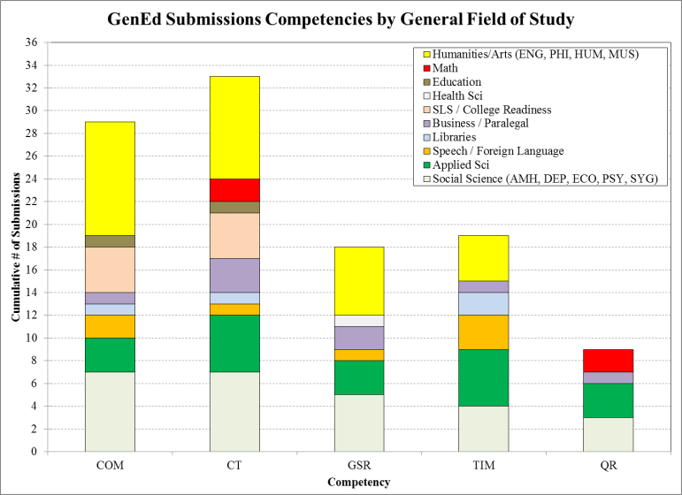
2014-2015 General education pilot submission Statistics

Slide 16
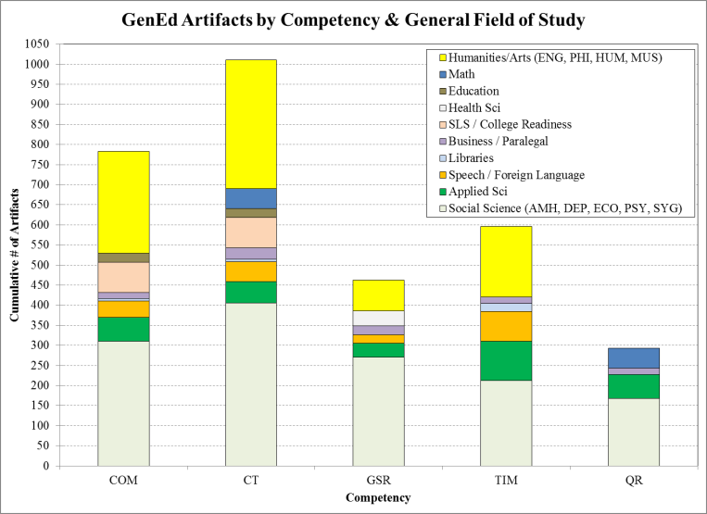
2014-2015 General education pilot submission Statistics

Slide 17
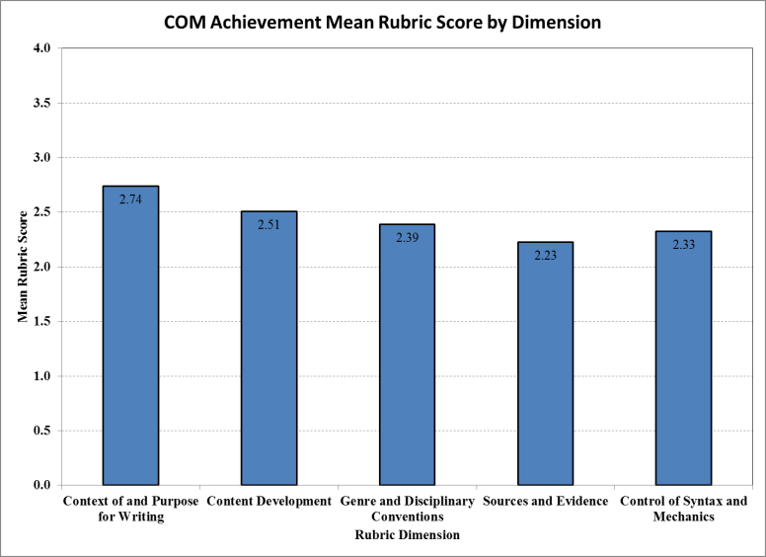
2014-2015 General education pilot Example Results

Slide 18
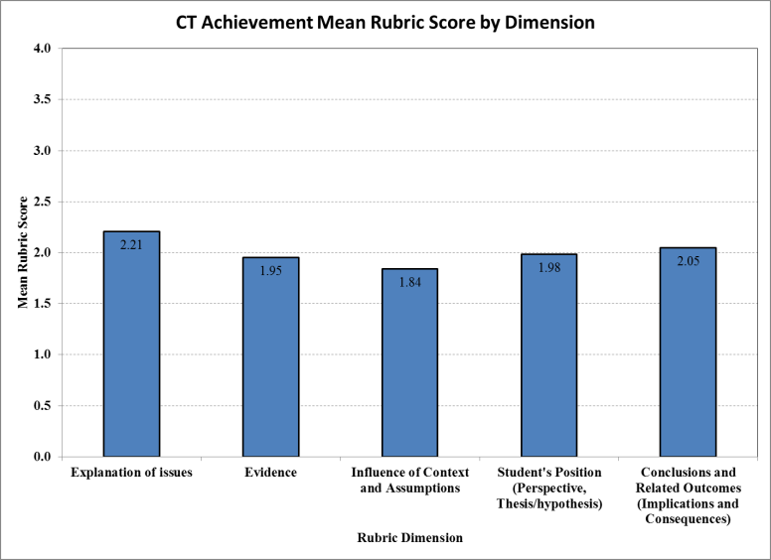
2014-2015 General education pilot Example Results

Slide 19
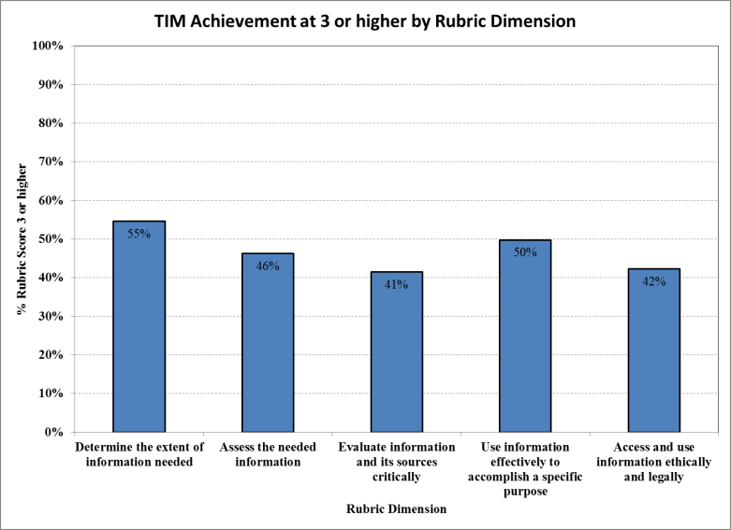
2014-2015 General education pilot Example Results

Slide 20
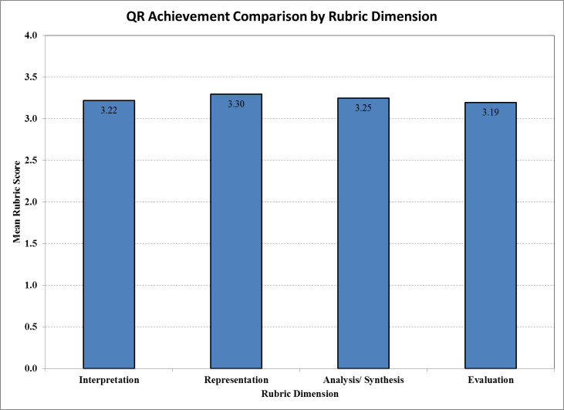
2014-2015 General education pilot Example Results

Slide 21
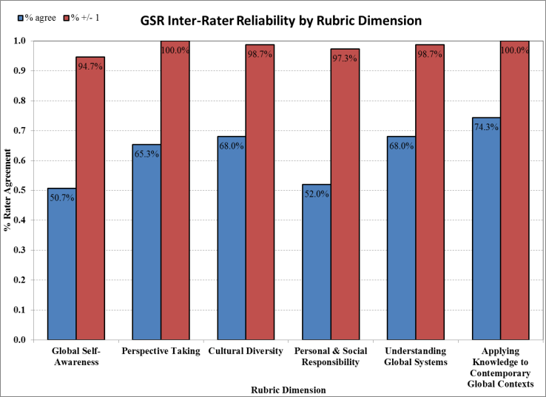
2014-2015 General education pilot Example Results

Slide 22
General Education Assessment
Preliminary results reviewed by the LAC Committee (4/17/2015) and with the Department Chairs and Scoring team members (5/7/2015).
Suggestions were made for a focus on professional development: Supporting research writing, helping students understand and avoid plagiarism, and developing writing assignment guidelines.
Two competencies identified as possible focus areas for AY 2015-2016 assessment: Communication (COM) and Critical Thinking (CT).

Slide 23
2015-2016 Initiatives
Meeting date – first Friday of the month
Facilitate communication with departments
Continuity of the committee
Mentoring new assessment coordinators
Professional Development
Writing-focused Best Practices and Exemplar Assignments
Assessment 101 Workshop
Develop a Course-Level assessment cycle
General Education Program
Develop a plan for the upcoming year
Refining collection process
Many opportunities for faculty to serve (College Service)
General Education Program Revision
Communicate the status to faculty members

