Slide 1
Florida SouthWestern State College’s Quality Enhancement Plan (QEP)
QEP Update
Eileen DeLuca, Assistant Vice President, Academic Affairs
Notes:
[

Slide 2
Career Interest Fall 2012

Slide 3
Career Interest Spring 2013

Slide 4
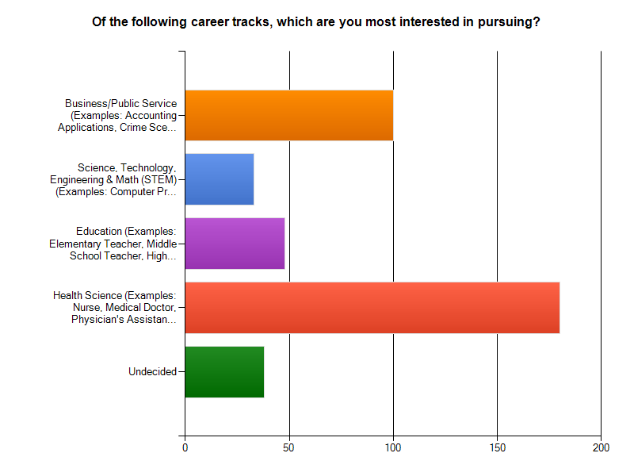
Career Interest Fall 2013

Slide 5
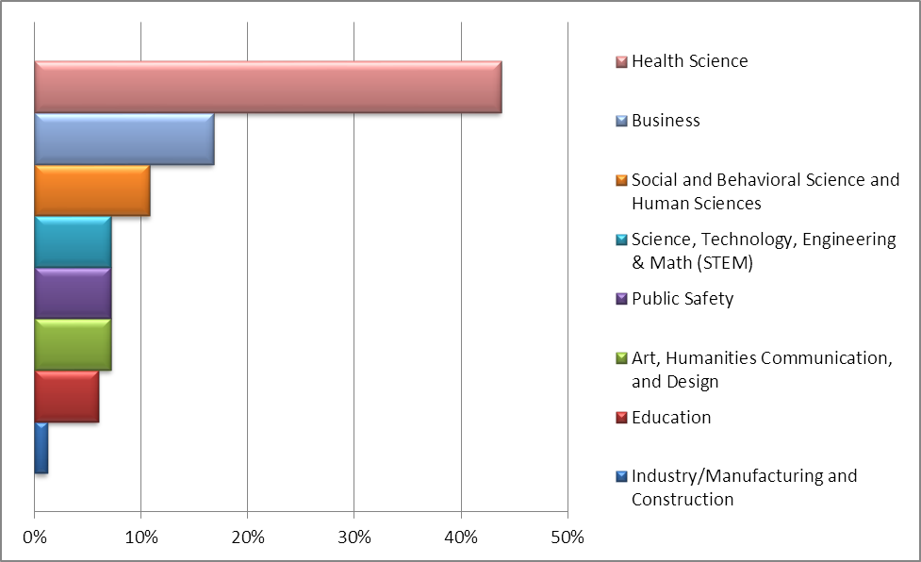
Career Interest Spring 2014

Slide 6
Meta-Major Declaration Fall 2014

Slide 7
Critical Thinking in Careers Series
Dr. Jeff Allbritten, President | Critical Thinking in Higher Education | Monday, October 13, 11:00-12:00, U-102 Collier G-109, Charlotte J-118, Hendry Glades A-110
Dr. Denis Wright, Provost | Critical Thinking in the Social Sciences | Thursday, October 9, 11:00-12:00
Dr. Emery Alford, Dean | Critical Thinking in Music and the Arts | Tuesday, September 23, 1:00-2:00
Dr. Marie Collins | Critical Thinking in the Health Professions | Tuesday, September 30, 1:00-2:00
Chitra Paul | Critical Thinking in Nursing | Tuesday, October 21, 5:00-6:00
Leslie Yaniga | Critical Thinking in the Health Professions | Thursday, October 30, 11:00-2:00
Julissa Rolan | Critical Thinking in the Health Professions | Monday, November 3, 11:00-12:00
Bobby Holbrook | Critical Thinking in the Health Professions | Monday, November 17, 2:00-3:00
Jenneine Lambert | Critical Thinking in the Health Professions | Thursday, November 20, 5:30-6::30 Tentative
Sindee Karpel | Critical Thinking in the Health Professions | Monday, October 27, 11:00-12:00
Dobin Anderson | Critical Thinking in Careers | Monday, October 10, 5:00-6:00

Slide 8
Cornerstone Critical Thinking Series
The 3rd Annual Cornerstone Critical Thinking Series
Thursday, November 6^{th.}
Dr. Christian Parenti-Critical thinking and environmental issues.
Dr. Parenti is an investigative reporter, author, and documentary maker. His most popular works are his books The Freedom and Tropic of Chaos along with his documentary “The Fixer.” http://www.christianparenti.com/
Lee Campus preview: 11:00 a.m.
Main event: Collier Campus 5:45pm.
You and a guest are invited to attend the panel discussion in the Auditorium. If you would to reserve a seat(s), you may RSVP to Professor Michael Granata at mgranata@fsw.edu or 805-338-3722. Please reserve early as the auditorium is expected to be filled.

Slide 9
Thank you for your participation!
http://www.fsw.edu/fye

