Slide 1
SCHOOL OF BUSINESS AND TECHNOLOGY
WELCOME BACK
September 11, 2020
Building from Disruption

Slide 2
AGENDA
Picture Here
Welcome
Student Success Update
Updates: Dean, Associate Dean, Chairs
Other Discussion
Departmental Breakouts

Slide 3
Student Success Update
Schulze Funds this year:
$58,555 spent through fall to date
Spring 2020: 3 students
Summer 2020: 9 students
Fall 2020: 88 students
Total potential number of certificates and/or licenses:
138

Slide 4
Updates from Dean
Scheduling in October
Certification exam updates
Update on BAS in IST
Update on potential new AS in Aviation Management – discussions with Charlotte Technical College
Update on Cares grant funding
Textbook adoption - Lisa
SOS Fall Surveys – ideas?
Other programmatic discussion/update?

Slide 5
New book rep – McGraw Hill
Emily Cearlock
National Sales Support
McGraw Hill | Higher Education
501 Bell St. Dubuque, IA 52001
emily.cearlock@mheducation.com
http://www.mheducation.com
Customer Service 800-338-3987
Technical Support 800-331-5094

Slide 6
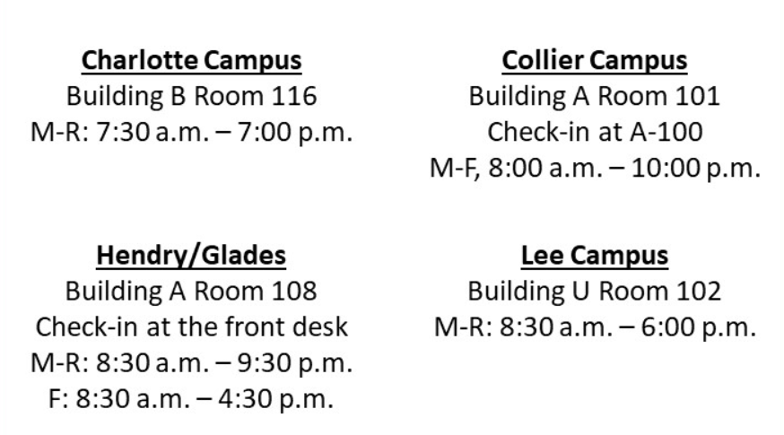

Slide 7
Updates from Dean
Picture Here
Announcing a new award –
For Bravest Faculty!
This month’s award goes to….
(drum roll here)

Slide 8
Professor Bob Knott at Collier, who had a visitor in class last week!

Slide 9
Associate Dean Update:
Jennifer Baker
Chair Updates:
Dr. Mary Conwell, Legal Studies, Architecture, Construction, and Engineering
Dr. Mary Myers, Computer Science
Dr. Jennifer Patterson, Business and Risk Management
Dr. Richard Worch, Criminal Justice, Public Safety Admin.
Picture Here

Slide 10
Other Discussion
Programmatic ideas
and/or Guest
speakers you’d like to
have in our upcoming
meetings?
Not too early to start
thinking about spring
schedules – process
will start in a few
weeks

Slide 11
2020-21 Looking Ahead (in no particular order…..)
More marketing initiatives
Career Planning and Placement Center
Entrepreneurship Center
More school and community partnerships

Slide 12
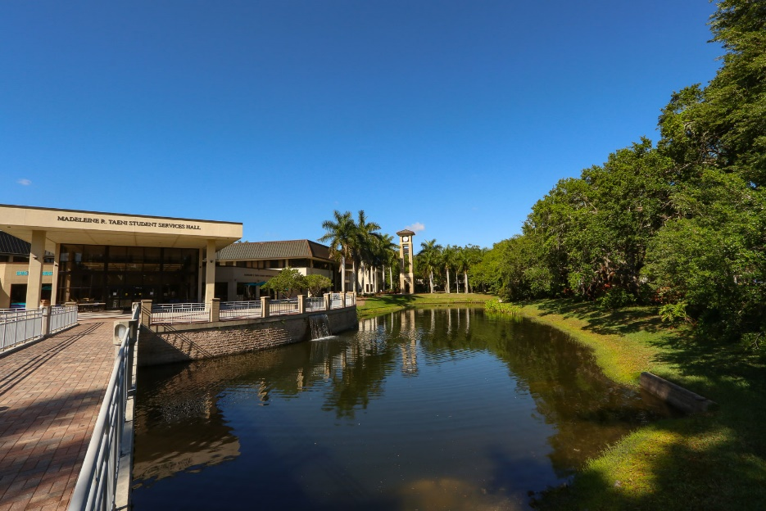
Q & A
DEPARTMENT BREAKOUTS

