Slide 1
Faculty Qualifications Best Practices Workshop
Office of Effectiveness & Accountability
Team AASPIRE
October 2021

Slide 2
High-Five FSW & Faculty Credentialing Stakeholders
Institution-wide:
Zero recommendations after on-site SACSCOC Committee visit
Faculty Credentialing (6.2a):
Zero citations of non-compliance after off-site SACSCOC Committee review
SACSCOC Most frequently cited Principles in 2019:
https://sacscoc.org/app/uploads/2020/02/Most_Frequently_Cited_Principles_2019_web.pdf
Examples from FSW 2021 Compliance Certification for Reaffirmation:
https://webapps.fsw.edu/online/SACS/html/pages/6.2.a.html

Slide 3
Poll Question 1:
Think about the number of credentialing form packets (IQF’s, FQF’s, PSAV’s) that go to Team AASPIRE for review:
How many are returned to the department?
0%-24%
25%-49%
50%-74%
75%-100%

Slide 4
Poll Answer 1:
Think about the number of credentialing form packets (IQF’s, FQF’s, PSAV’s) that go to Team AASPIRE for review:
How many are returned to the department?
0%-24%
25%-49%
50%-74%
75%-100%

Slide 5
Common FQF/IQF revisions? Audience Engagement

Slide 6
Common FQF/IQF revision examples
Handwritten items
Incorrect or incomplete Banner ID
Inaccurate form type
Institutions listed that are not necessary for qualification
Missing or incorrect course prefixes
Missing signatures and/or dates
GSH counts
Not attaching documentation to Alt-qualification
Degree, Major, Subject clarity – Refer and match to the transcript!

Slide 7
Supplemental Documents
Necessary
FQF’s
Transcript (or Cred Manager snip for updated FQF’s only)
Copy of Guidelines for listed course prefixes
Other relevant supplemental documents (licenses, certifications, etc.)
IQF’s
Transcripts
Relevant Certifications and/or Licenses
Unnecessary
Documents commonly sent but not needed
Employment applications
Resumes and CVs
Other licenses not needed for credentialing
Unnecessary transcripts
(Previous qualification forms)

Slide 8
Example Email Credentialing Report Variances – Action Required!
FALL 2019 | FORM TYPE (Faculty FQF or Instructional/Clinical IQF) | ISSUE/VARIANCE |  |  |  | RESPONSIBLE
 |  | Missing Official Transcript | Class Credentialing Variance | Licenses Expiring (or Missing Certs) | Other
Barry, Joseph | Updated FQF for Full-time Faculty status |  |  |  |  | Holbrook/Tropello
Fawcett, Tyler | Updated FQF |  | BCN1272 |  |  | Conwell/Psihountas
Heisinger, Gerald | Updated FQF |  | PSY 2146 |  |  | Housley/Teed
Platt, Dawn | Updated FQF |  | SBM 2000 |  |  | Patterson/Psihountas
Scott, Elbert | Returning IQF |  |  | Expired License |  | Holbrook/Voelpel/Tropello
Speziale, Richard | n/a | Official (Long Island U-Cw - MBA) |  |  |  | Patterson/Psihountas

Slide 9
Example Email Credentialing Report Entries
FACULTY | FORM TYPE (Faculty FQF or Instructional/Clinical IQF or Alt-QF) | QUALIFICATIONS ENTERED IN BANNER THIS PERIOD |  |  |  | STATUS | RESPONSIBLE
 |  | Transcript(s) Added | Class Credentials Added | Licenses/Certifications Added | Other
McGregor, Sarah | Returning IQF |  |  |  | Review Date | 1/14/2020 | Holbrook/Tropello
Franz, Gerald | New FQF | Unofficial (Univ of ALR - MS) | LIS 2004 |  | Review Date | 1/16/20 | Shuluk
Barnett, Jessica | Updated FQF |  | SLS 1515/1331; MAN 3301 |  | Review Date | 1/16/20 | Patterson/Psihountas
Clancy, Shaun | n/a | Official (Northwestern - Phd) |  |  |  | 1/16/20 | Romeo/McGarey

Slide 10
FQF Workflow
When to submit an FQF:
Brand new faculty
Paused/absent from teaching for 3 semesters in a row
Updating Full/Part time status
Teaching a course not previously taught/credentialed for
Updating education/licensure/certificate information
Department
Originate FQF & signed by Program Director/Chair & Dean, plus Associate Dean where applicable
Accountability/Effectiveness (A/E)
Preliminary Review
(Initial & date in corner)
Provost Office
Final Approval
HR
Turn “on” for class assignment;
Banner entry, digitization, and Archival
A/E
Banner Entry & signature
Note: each person who signs a qualification form should be checking all information for accuracy

Slide 11
New Hire FQF Workflow
When to submit a New Hire FQF: Any brand-new faculty without Banner ID
Department
Originate FQF & signed by Program Director/Chair & Dean, plus Associate Dean where applicable
Accountability / Effectiveness Office (A/E)
Preliminary Review
(Initial & date in corner)
Provost Office
Final Approval
A/E Office
HR
Turn “on” for class assignment;
Banner entry, digitization, and Archival
HR
Onboard Process
HR
Onboard Finish; Create & Add Banner ID
A/E Office
Banner entry & Signature
Full-Time Candidate
Offer Letter
Note: each person who signs a qualification form should be checking all information for accuracy

Slide 12
IQF Workflow
When to submit an IQF:
Brand new Clinical Associate/Instructional Staff
Updating education information
Department
Originate IQF & signed by Program Director/Chair & Dean, plus Associate Dean where applicable
Accountability /Effectiveness Office
Banner Entry (initial & date in corner)
HR
Banner entry, digitization, and Archival
Note: each person who signs a qualification form should be checking all information for accuracy

Slide 13
New Forms: Selecting Accrediting Agency
How do I know what to select for Accrediting Agency?
FSW qualified faculty obtain degrees & course work from regionally accredited institutions.
Step 1: Find the Accreditor - Search CHEA (https://www.chea.org/), check the back of the transcript, or check the institution’s website
Step 2: Verify the accreditation status with accreditor’s website:
ACCJC - Accrediting Commission for Community and Junior Colleges Western Association of Schools and Colleges
HLC - Higher Learning Commission
CHE-MSA - Middle States Commission on Higher Education
NECHE - New England Association of Schools and Colleges Commission on Institutions of Higher Education
NWCCU - Northwest Commission on Colleges and Universities
SACSCOC - Southern Association of Colleges and Schools Commission on Colleges
WASC Senior College and University Commission
How do we credential with foreign transcripts? What is NACES?
Foreign transcripts must also be accompanied by a foreign transcript evaluation. We only accept foreign transcript evaluations from a NACES member (National Association of Credential Evaluation Services). A NACES evaluation provides a report of the equivalency of foreign transcript information to a regionally accredited institution. (https://www.naces.org/members)

Slide 14
HR COP Timeline - Official Transcripts:
Unofficial transcripts may be used to initially certify a faculty member. All forms required of an employee, including any required academic transcripts and credentials, must be submitted within thirty (30) days of an employee’s first day of employment.
The same standard of practice may be used for alternative credentialing materials, when unofficial copies may be used initially but official copies are required by the end of the first semester of teaching.
For any faculty who has unresolved course credentialing issues on the first day of classes of the semester, the School or Division will have to remove the faculty from the schedule or have approval from the Provost to keep the faculty assigned to courses.
Faculty who fail to produce official transcripts and/or alternative credentials will not be allowed to teach after one semester.
All Official transcripts should be submitted to or requested from HR and only HR

Slide 15
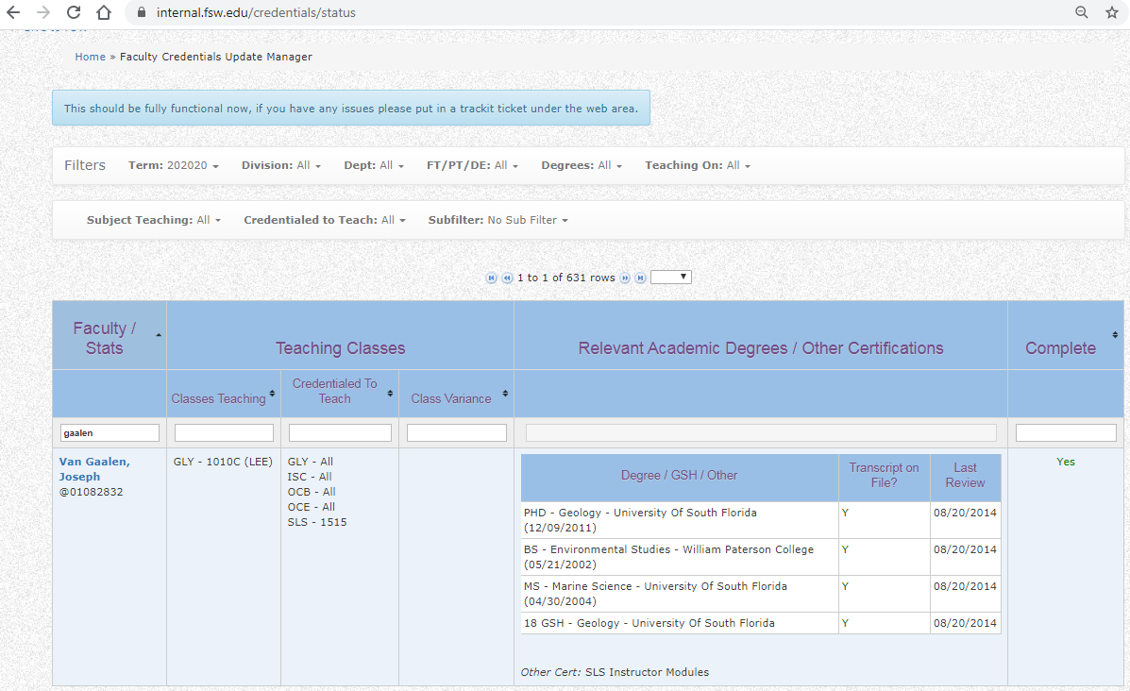
Faculty Credentialing Manager
For updated qualifications, snip of credentialing summary in credentialing manager…anyone need the link?
Click for current variances
https://www.fsw.edu/online/certificationlist

Slide 16
Preview new resource template:
Alt-Quals

Slide 17
Questions? Applause? Observations?
Sharing Best Practices

