Slide 1
Survey of Entering Student Engagement SENSE
http://www.ccsse.org/sense/
http://www.ccsse.org/sense/survey/bench_earlyconn.cfm

Slide 2
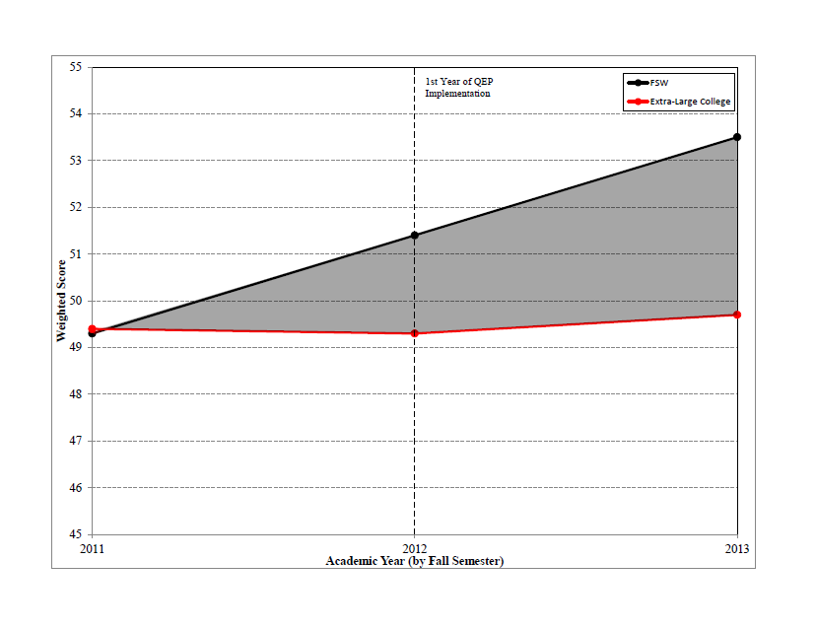
Engaged Learning Items

Slide 3
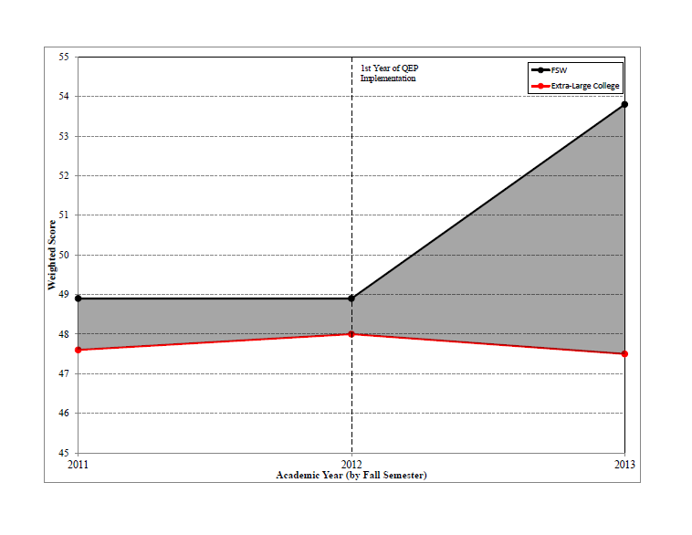
Clear Academic Plan and Pathway Items

Slide 4
FSW’s Areas of Highest Engagement in Fall 2013
An advisor helped me to select a course of study, program, or major
Participated in supplemental instruction
Used an electronic tool to communicate with an instructor about coursework
Used face-to-face tutoring
Used writing, math, or other skill lab

Slide 5
FSW’s Areas of Lowest Engagement in Fall 2013
The instructors at this college want me to succeed
At least one other student whom I did not previously know learned my name
At least one instructor learned my name
Used computer lab
Learned to improve my study skills within a class, or through another experience at this college

Slide 6
How can faculty support engagement?
Learn students names and use names for positive reinforcement.
Provide students opportunities to engage in discussion and problem-solving in pairs and groups.
Help students locate the Academic Support Centers and Peer Tutoring.
Teach and model discipline-specific study strategies.
Use the Early Alert System. https://www.fsw.edu/earlyalert

