Slide 1
Emerging Student Technologies
Presentation by Steven Kolberg

Slide 2
What are our students using?
Wireless Handheld Devices
Smart Phones
iPods
Game Systems
Tablet Computers
iPads
Laptops

Slide 3
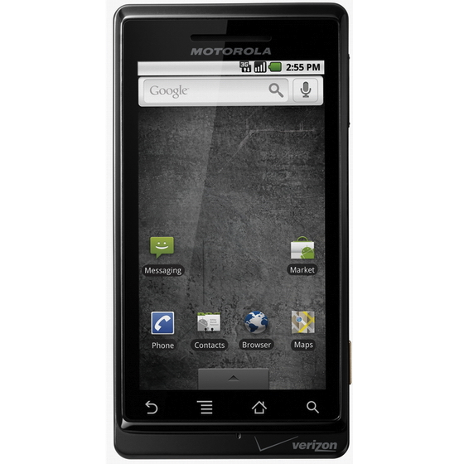
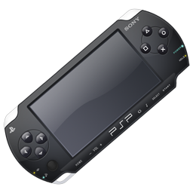
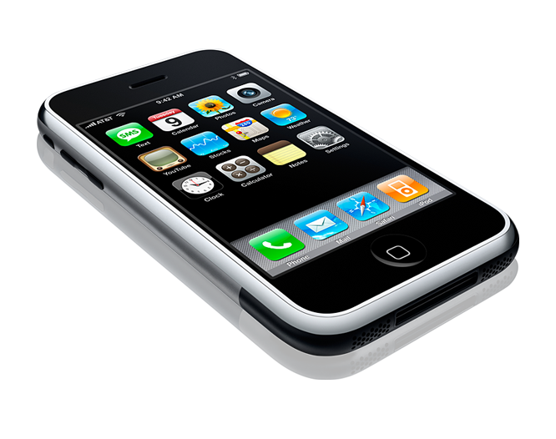
What Wireless Devices are out there?
iPhones
iPod Touch
Android enabled phones
PSP

Slide 4
iPhone
One of the best selling smart phones on the market.
Has the ability to download applications from iTunes for free or a fee.
Applications range from games to WorldCat.
Access the internet by either Wi-Fi or Data Connection.
Full Web browsing capabilities with Safari

Slide 5
iPod Touch
Is a mixture of the iPhone and iPod
No voice or data connection
Wi-Fi enabled
Web
Skype
Music player
Podcasts
Download applications
Same to those available for iPhone.

Slide 6
Android
Open Source smart phone operating system for small devices.
Fastest growing in popularity
High Speed performance
Android App Market
Anyone can create applications
Google acquired android in 2005
Native Google Interface
Can search by voice or even an image
Google apps
Google Docs
Gmail

Slide 7
PlayStation Portable [PSP]
Portable Gaming system from PlayStation.
Wi-Fi enabled
Can browse the internet
View movies
Play games

Slide 8
What is a Tablet Computer?
Touchscreen computer usually with the dimensions of a standard laptop screen.
Fully loaded with a standard operating system such as Windows, Apple OS X or Android.
Capabilities of a laptop or desktop computer but much lighter and more portable.
Have been around since the late 90’s but were not as popular.

Slide 9
iPad
Becoming one of the fastest selling tablet PCs available.
Runs iPhone applications and others specifically designed for it.
Light-weight and high speed performance
Can be used for reading Kindle eBooks and CourseSmart textbooks
They do not support Flash.
Yet…

Slide 10
Laptops
Still a mainstay on college campuses.
Very expandable through USB hardware
Bluetooth
Wireless Broadband
Wi-Fi
Have a wide variety of programs available to them, same amount as desktop computers.

Slide 11
Questions?
?
?
?
?
?
?
?
?
?
?
?
?
?

