Slide 1
A Celebration of Theater Exhibition
Edison State College Richard H. Rush Library

Slide 2
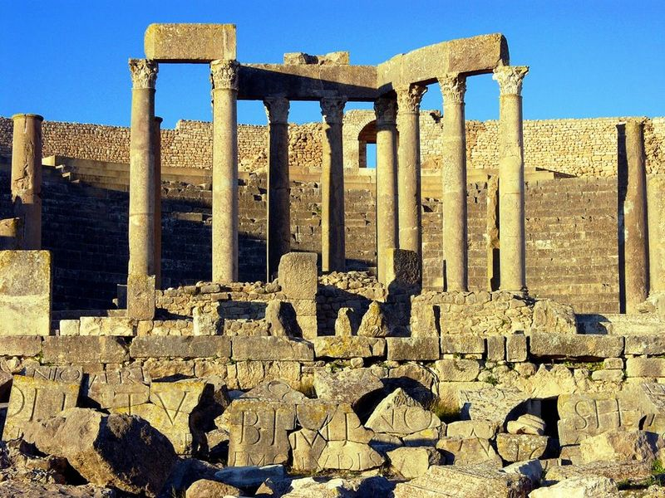
Dougga Theatre, Tunisia

Slide 3
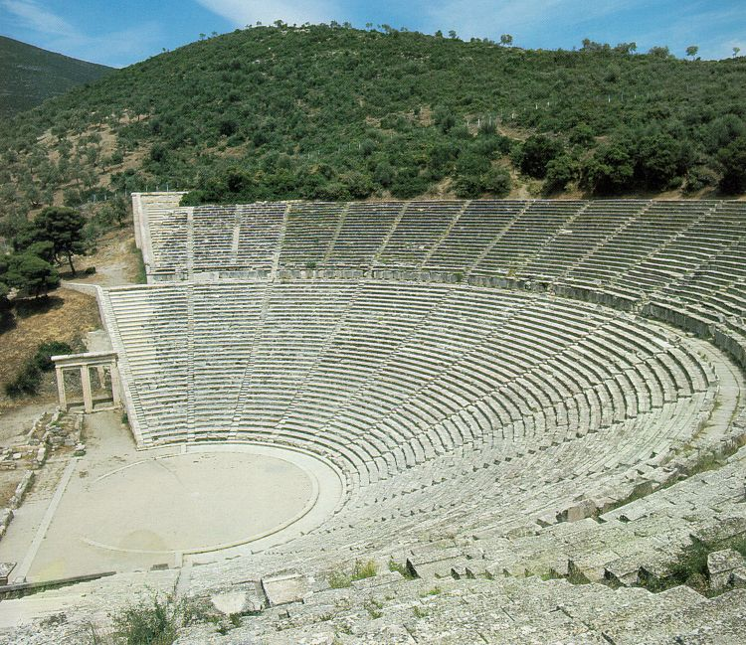
Epidaurus Theatre, Greece
Notes:
Epidaurus Theatre, Greece

Slide 4
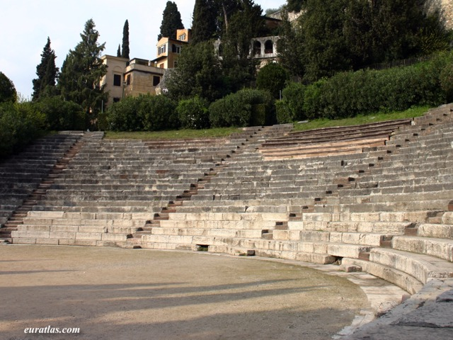
Roman Theatre, Verona, Italy
Notes:
Roman Theatre, Verona, Italy

Slide 5
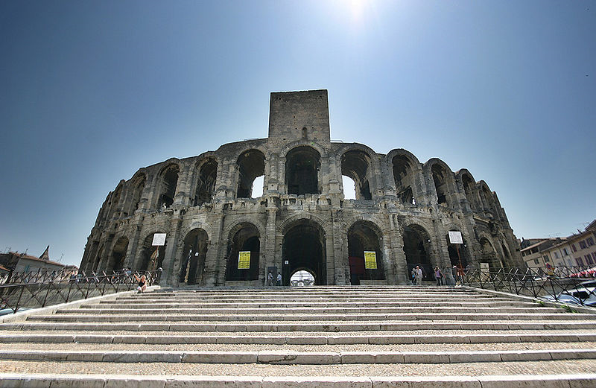
Amphitheatre, Arles, France
Notes:
Amphitheatre, Arles, France

Slide 6
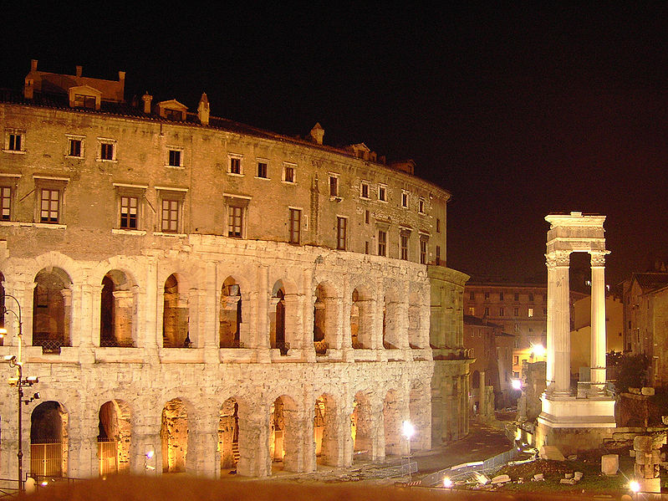
Theatre of Marcellus, Rome
Notes:
Theatre of Marcellus, Italy

Slide 7
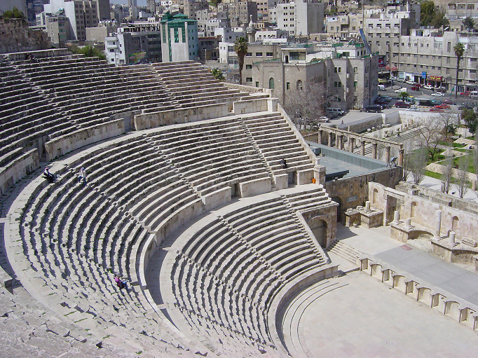
Roman Theatre, Amman, Jordan
Notes:
Roman Theatre, Amman, Jordan

Slide 8
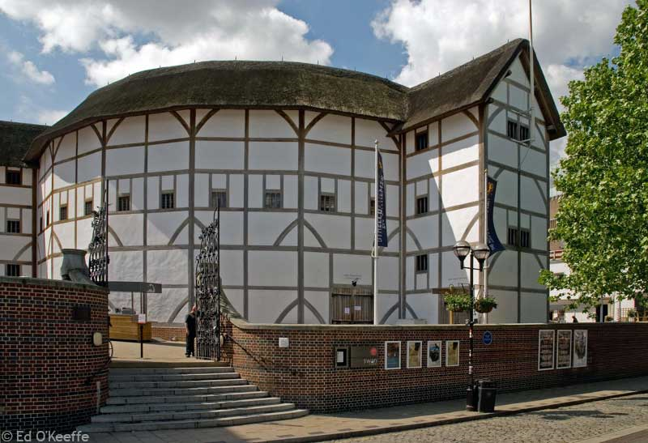
Globe Theatre, London
Notes:
Globe Theatre, London

Slide 9
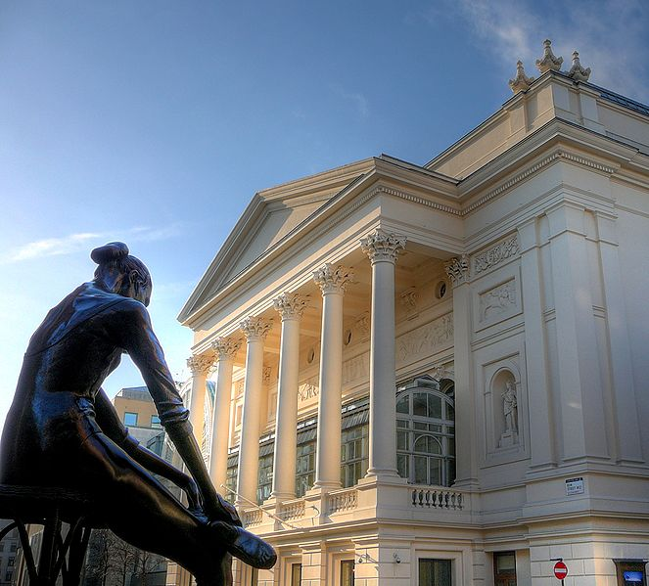
Royal Opera House, London
Notes:
Royal Opera House, London

Slide 10
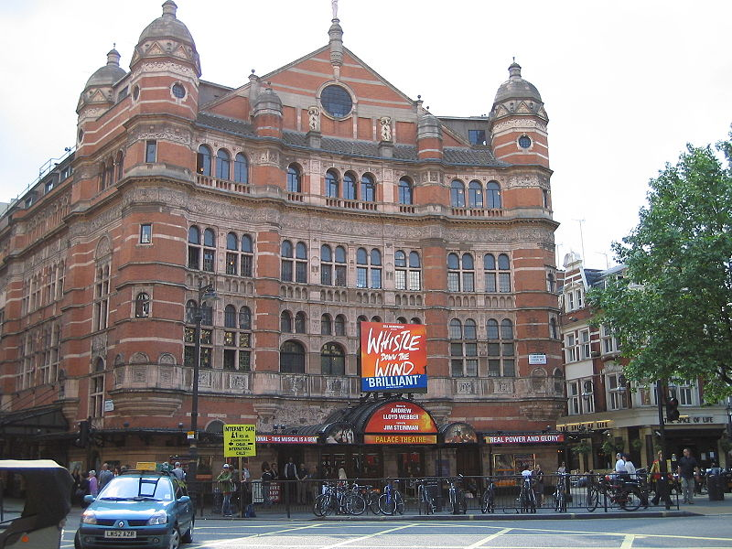
Palace Theatre, London
Notes:
Palace Theatre, London

Slide 11
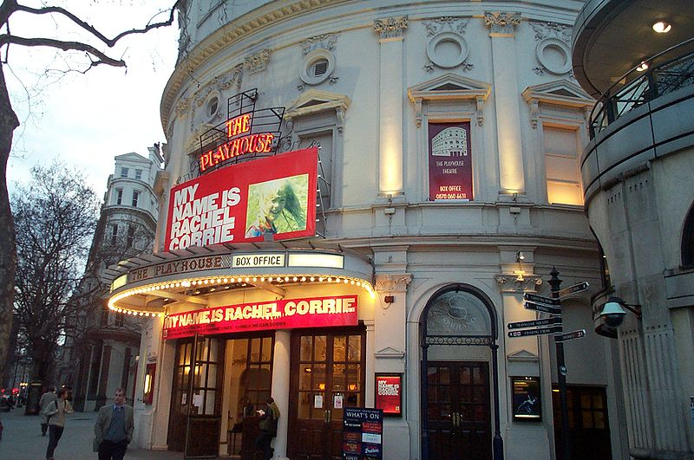
Playhouse Theatre, London
Notes:
The Playhouse Theatre, London

Slide 12
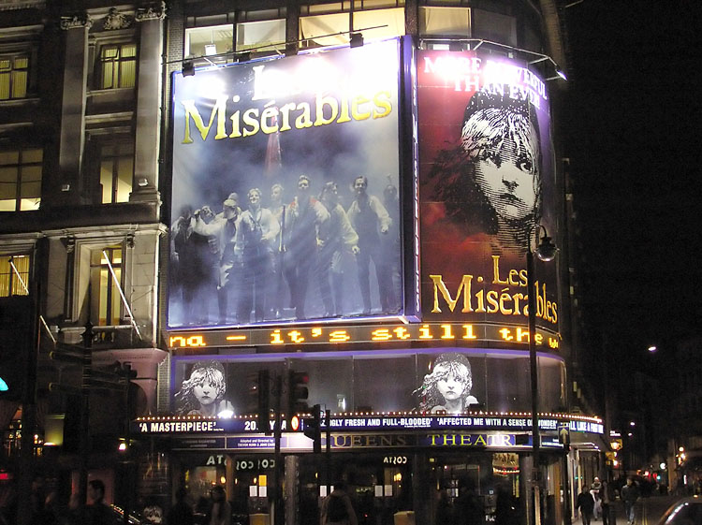
Queens Theatre, London
Notes:
Queens Theatre, London

Slide 13
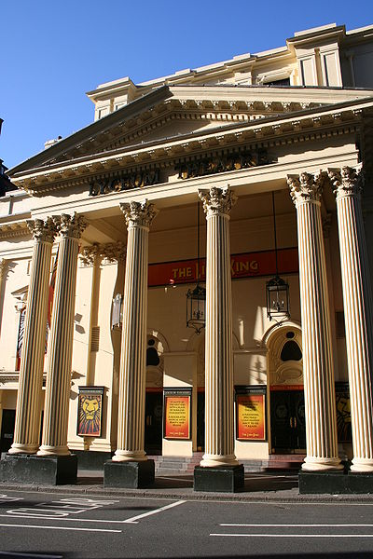
Lyceum Theatre, London
Notes:
Lyceum Theatre, London

Slide 14
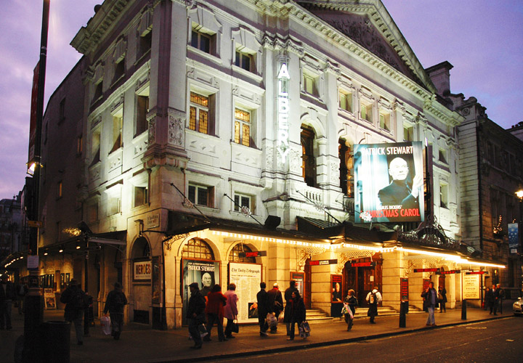
The Albery Theatre, London
Notes:
The Albery Theatre, London

Slide 15
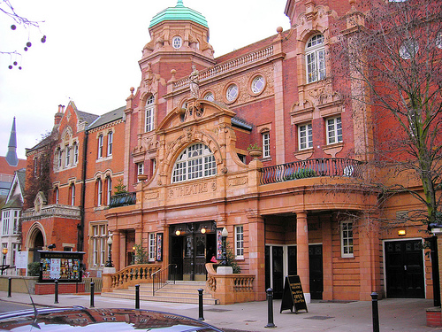
Richmond Theatre, London
Notes:
Richmond Theatre, London

Slide 16
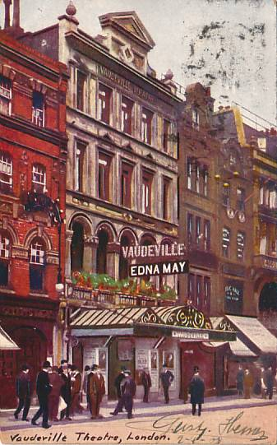
Vaudeville Theatre, London
Notes:
Vaudeville Theatre, London

Slide 17
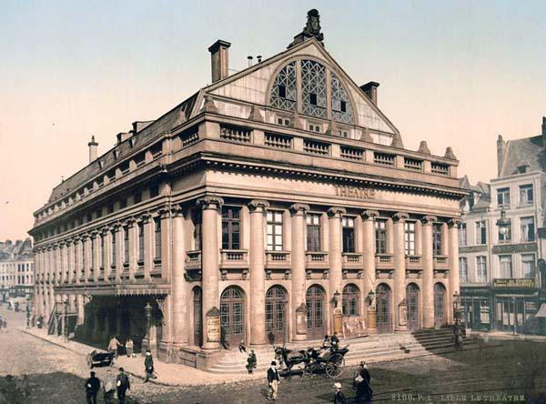
The Theatre, Lillie, France
Notes:
The theatre, Lillie, France

Slide 18
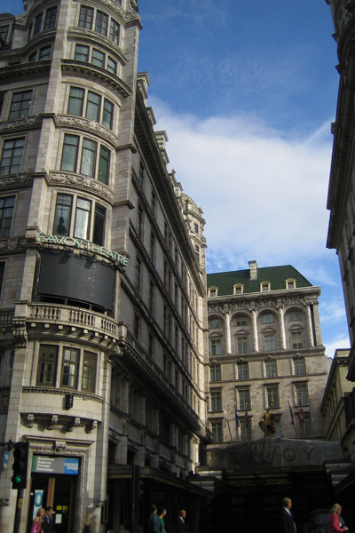
Savoy Theatre, London
Notes:
Savoy Theatre, London

Slide 19
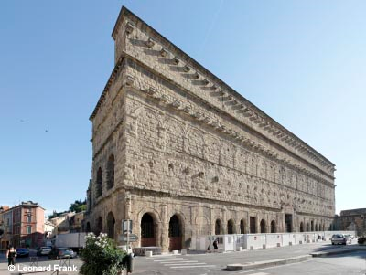
Roman Theatre of Orange, France
Notes:
Roman Theatre of Orange, France

Slide 20
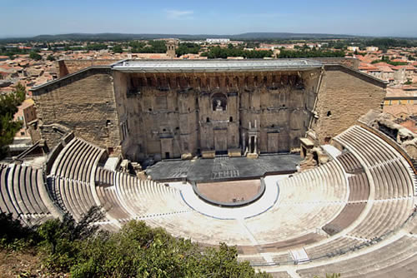
Roman Theatre of Orange, France

Slide 21
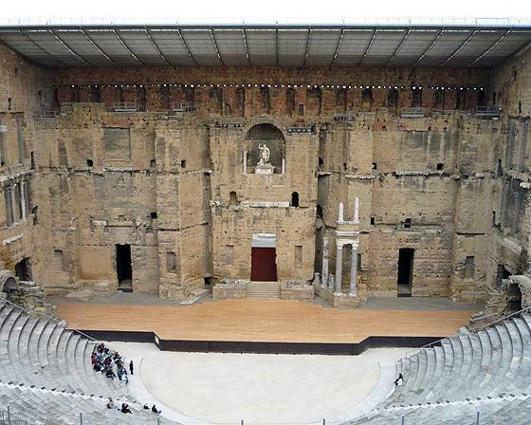
Roman Theatre of Orange, France
Notes:
Roman Theatre of Orange, France

Slide 22
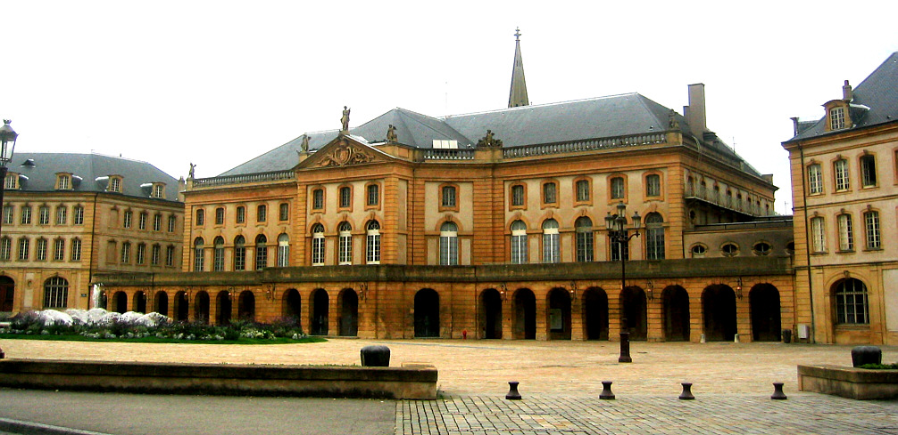
Metz Opera Theatre, France
Notes:
Metz Théâtre, France

Slide 23
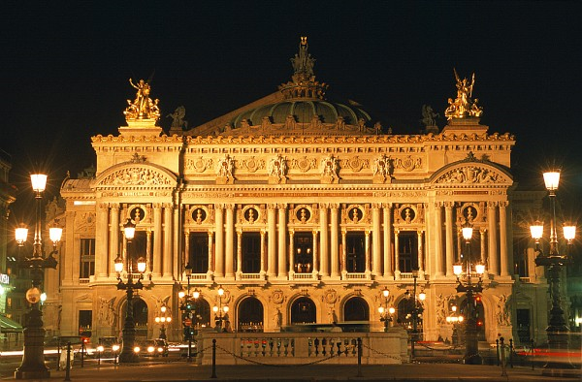
Garnier Opera, Paris
Notes:
Garnier Opera, Paris

Slide 24
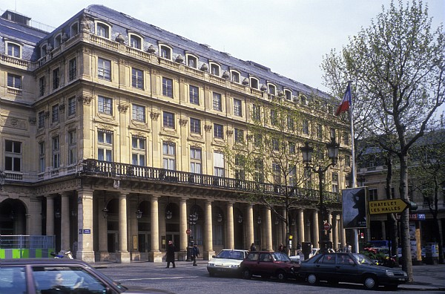
Comédie Française, Paris
Notes:
Comédie Française, Paris

Slide 25
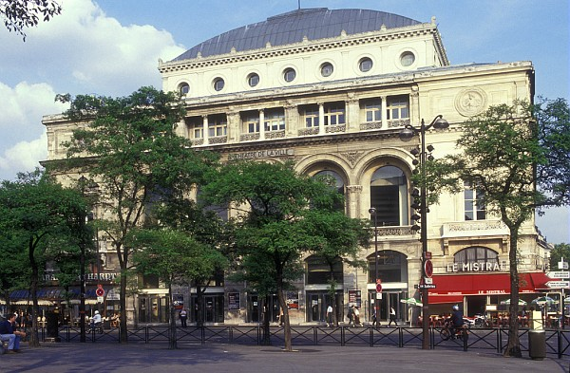
Théâtre de la Ville, Paris
Notes:
Théâtre de la Ville, Paris

Slide 26
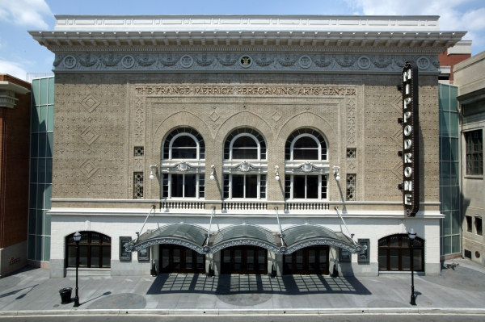
Hippodrome Theatre, Baltimore, Maryland
Notes:
Hippodrome Theatre, Baltimore, Maryland

Slide 27
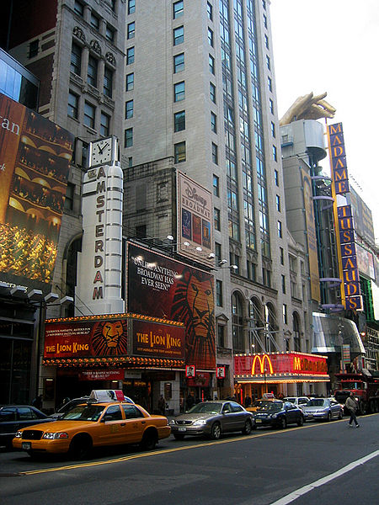
New Amsterdam Theatre, New York City
Notes:
Amsterdam Theater, New York City

Slide 28
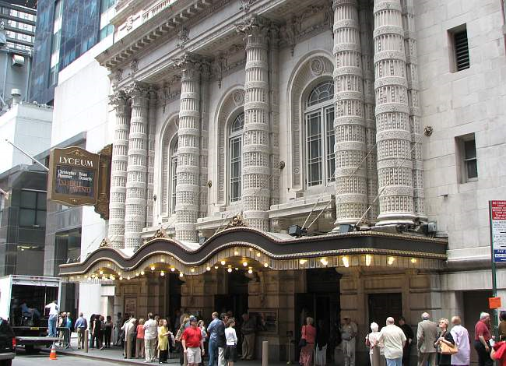
Lyceum Theatre, New York City
Notes:
Lyceum Theatre, New York City

Slide 29
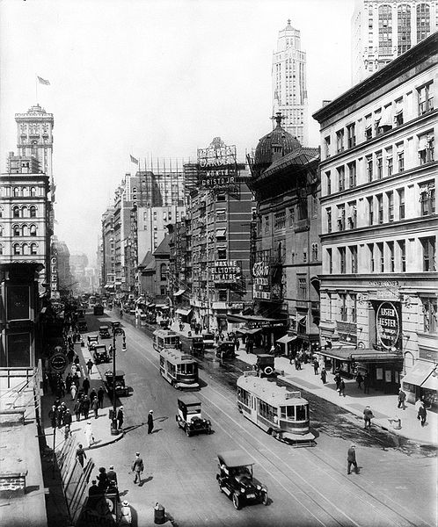
Winter Garden, Maxine Elliott’s, Casino, & Knickerbocker Theatres, New York City
Notes:
The Winter Garden, Maxine Elliott's, Casino, and Knickerbocker Theatres, New York City

Slide 30
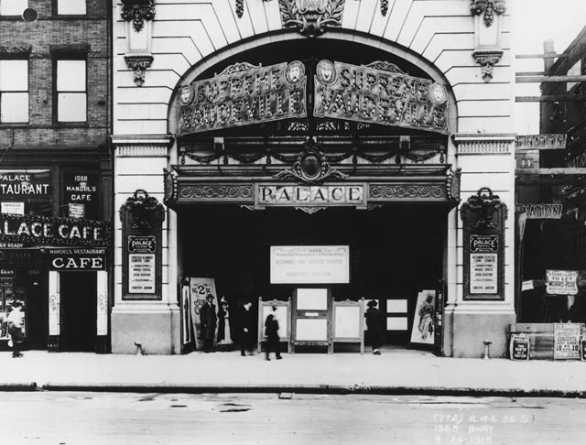
Palace Theatre, New York City
Notes:
Palace Theatre, New York City

Slide 31
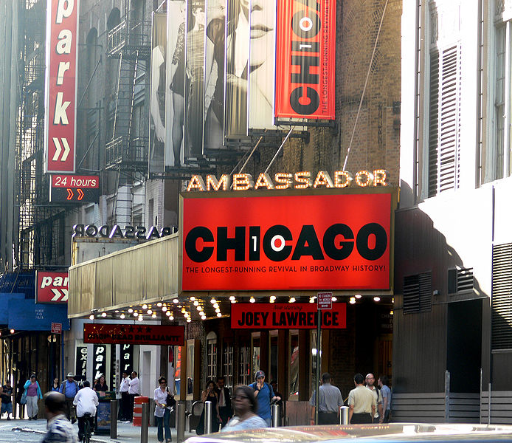
Ambassador Theatre, New York City
Notes:
Ambassador Theatre

Slide 32
New Amsterdam Theatre, New York City
Notes:
New Amsterdam Theatre, New York City

Slide 33
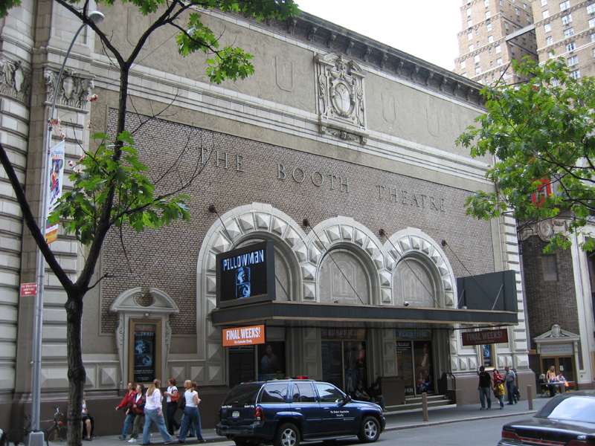
Booth Theatre, New York City
Notes:
Booth Theatre, New York City

Slide 34
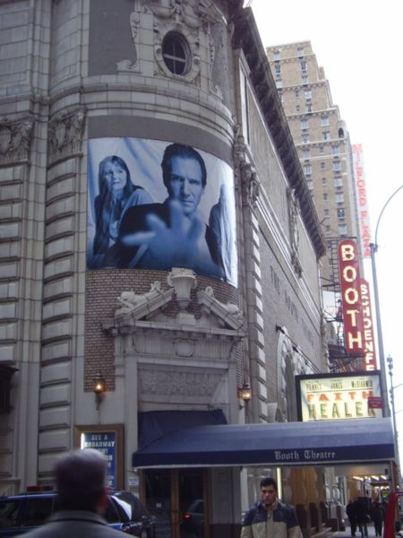
Booth Theatre, New York City
Notes:
Booth Theatre, New York City

Slide 35
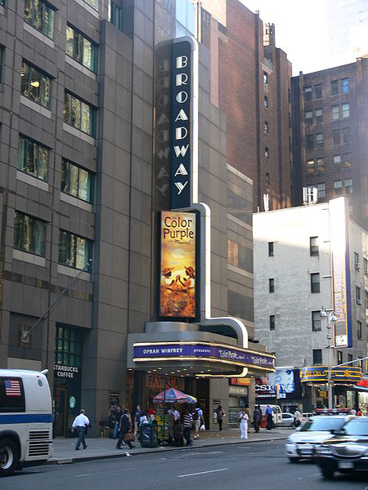
Broadway Theatre, New York City
Notes:
Broadway Theatre, New York City

Slide 36
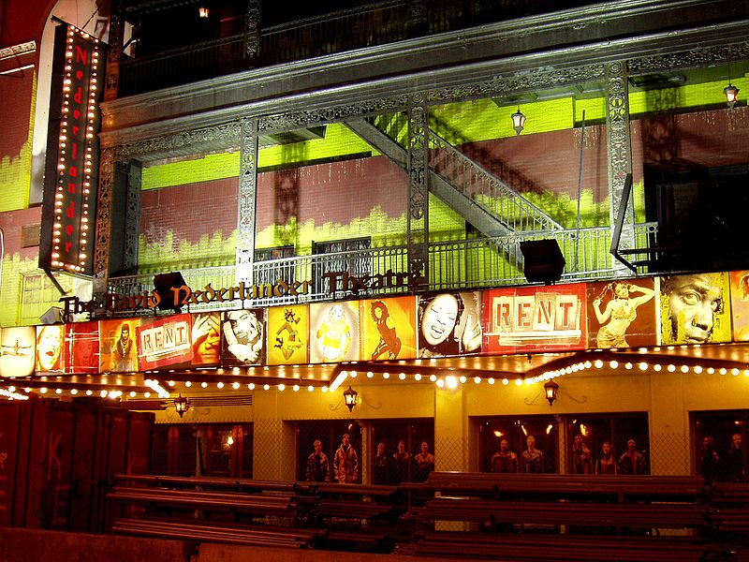
Nederlander Theatre, New York City
Notes:
Nederlander Theatre, New York City

Slide 37
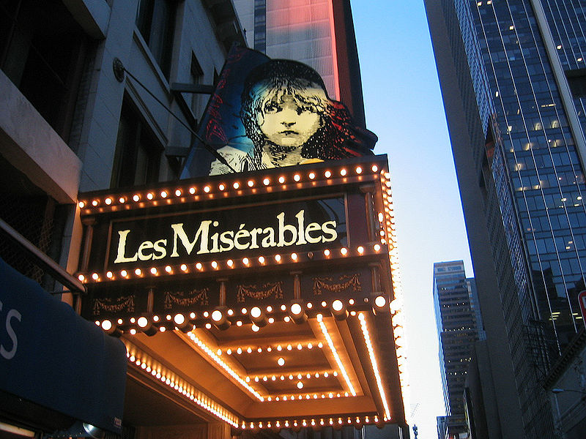
Imperial Theatre, New York City
Notes:
Imperial Theatre, New York City

Slide 38
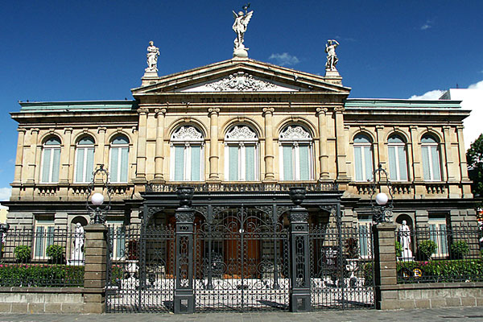
National Theatre, San José, Costa Rica
Notes:
Palace Theatre, New York City

Slide 39
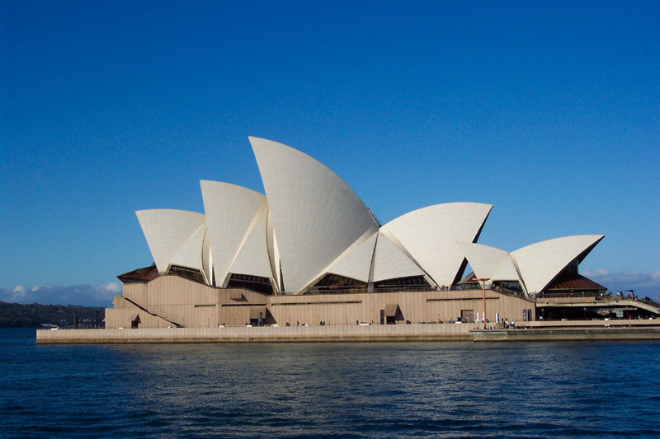
Sydney Opera House, Australia
Notes:
Sydney Opera House, Australia

Slide 40
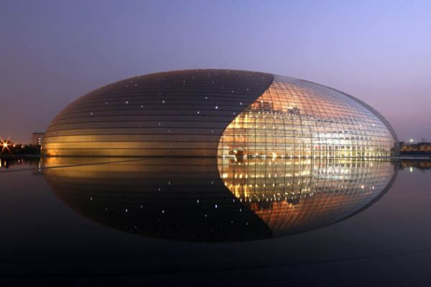
National Grand Theater, China
Notes:
National Grand Theater, China

Slide 41
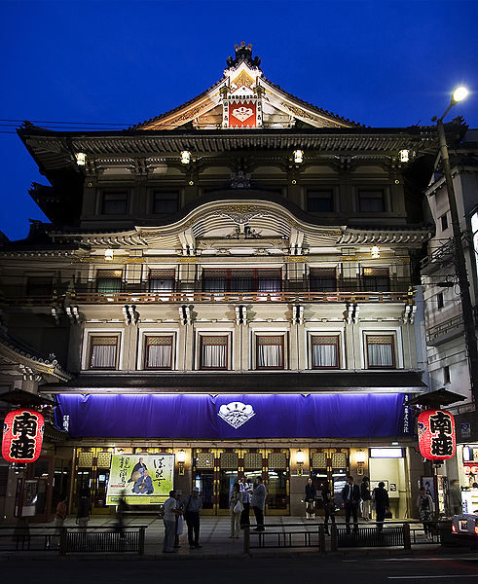
Minami-za Theatre, Japan
Notes:
Minamiza Theatre, Japan

