Slide 1
SCHOOL OF BUSINESS AND TECHNOLOGY
Architecture and Construction Advisory Board Meeting
NOVEMBER 12, 2020

Slide 2
AGENDA
Picture Here
FALL MEETING AGENDA
Greetings & Introductions
Update on Programs
New Arch/Constr/Eng faculty
Class events
New job-seeking events
Other updates
Next meeting items and Close

Slide 3
Program Updates
Associate of Science in Architectural Design and Construction Technology:
Fall 2019: 103 students, 45 pt, 58 ft
Av. Age 24.4, 28 female, 22.18 size
Degrees conferred: 19
Fall 2019 is highest enrollment 14-19
Compared to 2015: 48, 22pt, 26ft
Av age 25.5, 15 female, 24.5 size
Degrees conferred: 7

Slide 4
Program Updates, Continued
Associate of Science in Civil Engineering Technology:
38 in Fall 2019 15 ft 23 pt, 25.8 av age, 5 female of the 38, avg course size 26.9
34 in Fall 2014, 14 ft, 20 pt, 4 female
Avg course size 22 age 26
Note: enrollment high was in 2016 at 65

Slide 5
Program Updates, continued
Have removed CCC Engineering Support Specialist from SOBT curriculum –zero enrollment
Are reviewing other possible certificates we can add – perhaps relating to LEED, other
Are reviewing adding professional certification competencies/material to existing courses

Slide 6
New Faculty
Full-time faculty hired! Started August of this year – please welcome Professor John Montoya
Claire Etienne
Carlos Marcet not available spring 2021
A huge thanks to Munir (Max) Al-Suleh who helped immensely last year as we conducted our search for a full-time faculty member

Slide 7
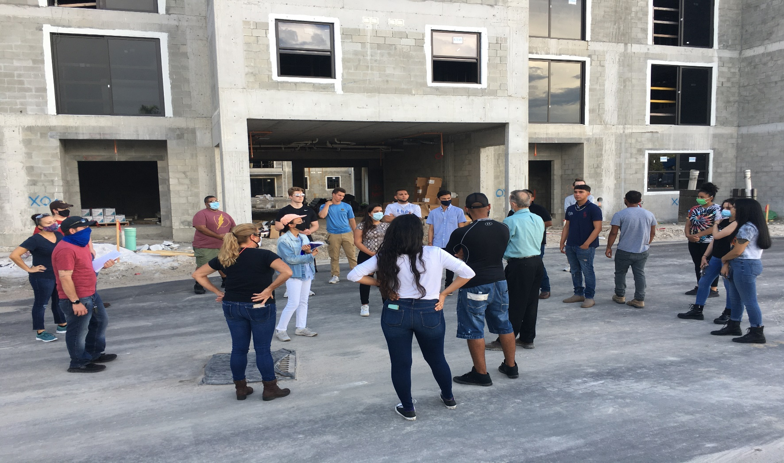
Class events-Professor Marcet: Fall 2020 Architecture Field Trip Thanks to GM – Steve Boling, Brooks Freund
New “West End at Citywalk” Job Site

Slide 8
Job Seeking Events
April 2 All-SOBT job fair was canceled. Decision made to hold a ‘live’ event in spring 2021, although with recent case rises, we’ve decided to schedule as virtual job expo
Please mark your calendars and spread the word:
Thursday, February 11th, 3 to 6 pm – no cost to employers

Slide 9
OTHER UPDATES
Schulze grant and CARES grant – weren’t able to do much for-credit assistance with existing architecture/construction portfolio of programs
Are planning to use CARES funds in spring term to tie CAD professional certification to current courses – will use funds to pay for certification exams for students as well as tuition benefits

Slide 10
Other updates, continued
Some slow-down in work opportunities coming through our office

Slide 11
Next meeting items and Close
Any agenda items you’d like to have added for the spring meeting?
We are always looking for more support for our students – if you would like to work with us on creating any scholarships, please contact me

Slide 12
Q&A/General Discussion

Slide 13
Next Advisory Board Meeting: Spring 2021

