Slide 1
SCHOOL OF BUSINESS AND TECHNOLOGY
4th MONTHLY MEETING
November 13, 2020
1-2 PM
Building from Disruption

Slide 2
AGENDA
Picture Here
Greetings and Agenda
Announcements
Introduction of Vice Provost
New Library Resources
Chair and Associate Dean reports
Dean Update
Discussion
Departmental Breakouts

Slide 3
Student Feedback:
Picture Here
I have had Christopher Renda, B.S, as my councilor for a couple years now and I just want to say how amazing and intuitive this councilor is. He has helped me every time I have had a question and need. I would highly recommend to my other students to seek out to him if they have any needs. Extremely great person and support!

Slide 4
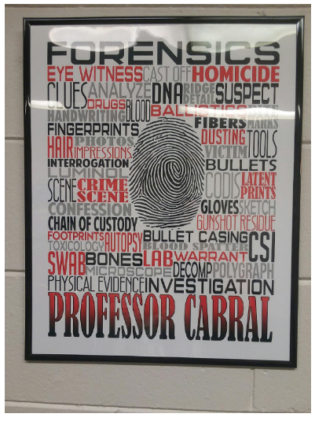

Slide 5
SOBT Faculty Updates
Picture Here
Mike Nisson – congrats on your pending retirement
Dr. Deborah Johnson – we wish Dr. Johnson well with her retirement
Search progressing well for new CJ/PAD faculty member
Will initiate search for new Computer Science faculty

Slide 6
Introduction of Vice Provost Tom Norman, Ed.D.
Picture Here
Dr. Norman joined FSW mid-July of this year.
Educational Background:
Doctorate in Education Policy
Master of Arts, Public Administration
Previous position:
Dean of University Extended Education at Minnesota State University

Slide 7
New Library Resources for Faculty
Picture Here
Welcome - Professor Bill Shuluk Shuluk

Slide 8
Chair and Associate Dean Reports:
Picture Here
Dr. Mary Myers
Dr. Jenny Patterson
Dr. Richard Worch
Dr. Mary Conwell
Associate Dean Update – Jennifer Baker

Slide 9
Departmental BREAKOUTS: 2-3:30 No December Meeting Next Meeting: January Duty Days

